Slide 1
U.S. Energy Upsurge The Path to U.S. Jobs, Prosperity, and Security
Kathleen Hartnett White Distinguished Senior Fellow and Director Armstrong Center for Energy and the Environment Texas Public Policy Foundation April 2012

Slide 2
Energy is the Nervous System of the U.S. Economy
“In the last 100 years, America’s population has tripled. Life expectancy has increased 70 percent. The productivity of the American people, measured in terms of real per-capita Gross Domestic Product (GDP) has increased by 600 percent. At the same time, we have consumed more than 340 billion barrels of oil, almost 60 billion short tons of coal and more than 1,090 trillion cubic feet of natural gas.”
These things are linked. Affordable and reliable energy is a crucial factor in making these and many other significant human, social and technological achievements possible.”
--- Rob Bradley, President, Institute for Energy Research

Slide 3
“The Western Hemisphere’s Oil Renaissance”
The oil industry was born in the United States a century and a half ago in the hills of Western Pennsylvania. And for the industry’s first hundred years, the Western Hemisphere was the leading petroleum-producing region in the world. But after World War II, oil production from the Middle East began to grow spectacularly, a development that only accelerated in the 1950’s and 1060’s. ….
Now a new energy axis is emerging, running from western Canada, through North Dakota and Texas to Brazil. It is leading to a revival in hemispheric oil production, one with major implications … for the world economy and geopolitics. … it has happened almost accidentally , a product of market signals and quite separate [private] initiatives and technological advances.
Daniel Yergin and James Burkhard, WSJ, March 6, 2012

Slide 4
An Ironic Coincidence
Historic Upsurge in U.S. Energy Production versus the End of the Era of Fossil Fuels
Game-changing New Access to Vast Stores of U.S. Oil and Natural Gas
Scale of the Boom Under-estimated and Under-reported
U.S. always has been the Saudi Arabia of Coal
U.S. (North America) could be largest producer of oil and gas in the world by 2017 and energy independent by 2020.

Slide 5
An Ironic Coincidence:
But President Obama Wants to End the Era of Fossil Fuels
First Coal, then Oil and then Natural Gas.
Sets Goal of 80% Clean Energy by 2035.
2011: wind at 1% and solar at 0.1%

Slide 6
U.S. Energy Scarcity is a Myth
Save the “Peak Oil” Worries for Several Centuries
Scarcity Myths Used to Justify Government Control: Rationing
New Technologies Provide Access to Staggering Volumes of Oil and Natural Gas.
Hydraulic Fracturing- originated in 1940’s but now with critical refinements
Horizontal/Directional Drilling
Micro-seismic Imaging and Sensors- Precision Mapping and Drilling
As if Overnight: Since 2005 increasingly widespread deployment in U.S.
Technological Breakthrough Attributed to a Single Entrepreneur
George Mitchell, Houston .
Releases “Tight Oil” found in America’s massive shale formations and mature, conventional wells.

Slide 7
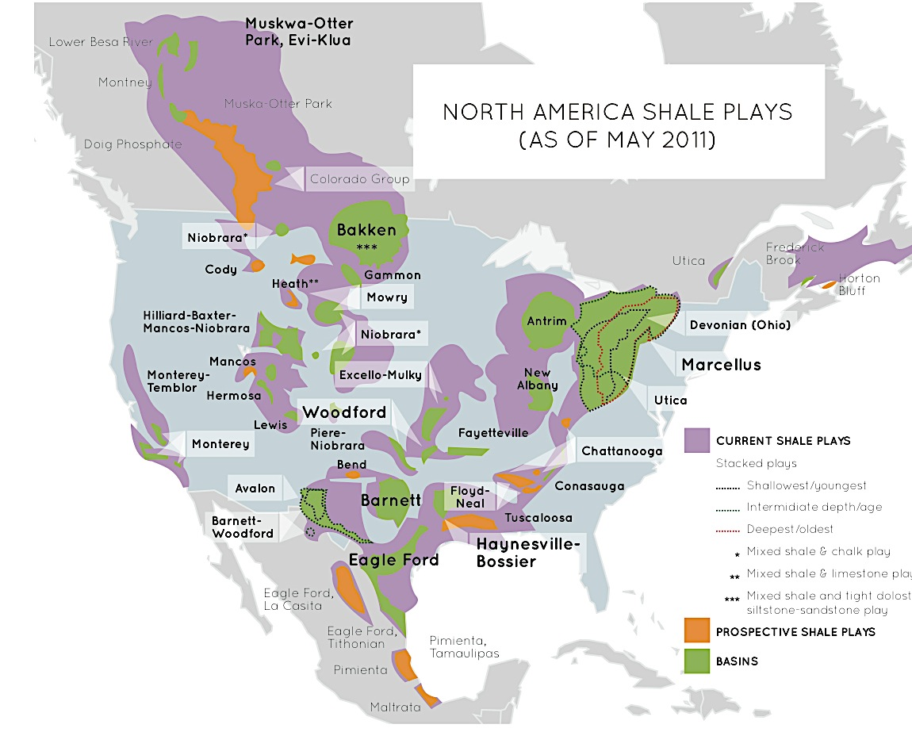
Source: U.S. Energy Information Administration Based on Data From Various Published Studies. Canada and Mexico Plays From ARI. Last Updated: May 9, 2011

Slide 8
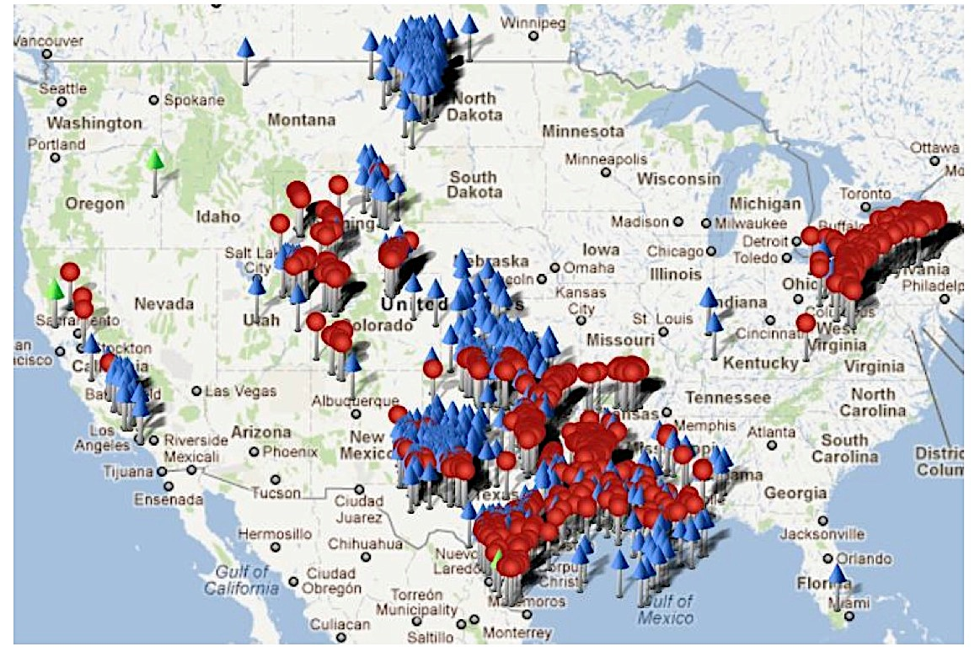
Rig Count and Permits
Source: Baker Hughes Interactive Rig Count Jan 25, 2012

Slide 9
Williston Basin Production
Source: NDIC

Slide 10
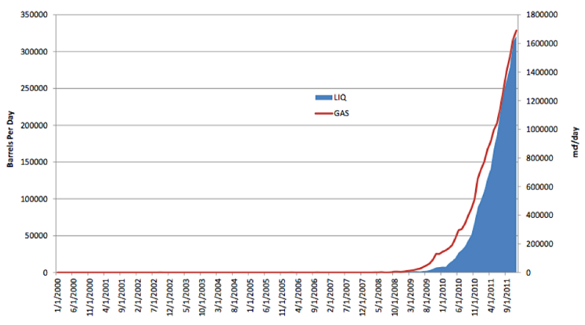
Eagle Ford Production
Source: HPDI March 21, 2012

Slide 11
U.S. “Massive Resource Potential”
Total Oil: 3.745 Trillion Barrels Recoverable: 1.442 Trillion Barrels Proved Reserves: 20.6 Billion Barrels*
Total Natural Gas: 14 Quadrillion Cubic Feet=1,000,000,000,000,000 /CF Recoverable: 2.744 Quadrillion Cubic Feet Proved Reserves: 272 Trillion Cubic Feet
Total Coal: 10.3 Trillion Short Tons Recoverable: 486.1 Billion Short Tons Proved Reserves: 260.6 Billion Short Tons
Ample U.S. Supply for Centuries
Source: “North American Energy Inventory,” December 2011, Institute for Energy Research.

Slide 12
The Scarcity Myth
Grossly Misleading: “Proved Reserves”
President Obama in Denial- “When the US only has 2% of world’s reserves and uses 20% of world’s reserves, how could drilling more make a difference.”
The Presidents “2%” refers to the traditional, most conservative measure and now antiquated measure of “proved reserves.”
EIA still estimates US proved reserves at only 21-23 billion barrels.(BBO).
Reserves –not static , e.g. food on grocery shelves
From 1980-2010, U.S. produced over 77 BBO
150% of the “proved reserves” EIA estimated in 1980.
In Eagle Ford Shale Area of TX, production as quadrupled each of the last three years. In 2009, 94 drilling permits issued. In 2010, 1000 plus drilling permits.

Slide 13
DOE’s Energy Information Administration (EIA) “official” energy numbers
Proved Reserves- Known oil resources now producible with government consent using current (conventional) technology, prices and commercial terms. Note excludes resources now off limits – offshore, onshore on public lands.
Technically Recoverable Resource-Known resources capable of recovery but with more cost and technical difficulty.
Probable Resources – Identified but incapable of measurement.

Slide 14
Tight Oil and Shale Gas Revolution Made Possible by Fracking and Directional Drilling Blows EIA’s Numbers
USGS Estimates of Bakken (AKA Williston Fields) in ND/MT were 151 MBO in 1995.
In 2010, USGS increased the Bakken numbers to 4.3 BBO, an increase of 132 times in ten years.
Oil analysts now predict the Bakken holds more like 20-24 BBO.
Eagle Ford -60,000 bpd in 2011, likely 500,000 bpd by 12/12.

Slide 15
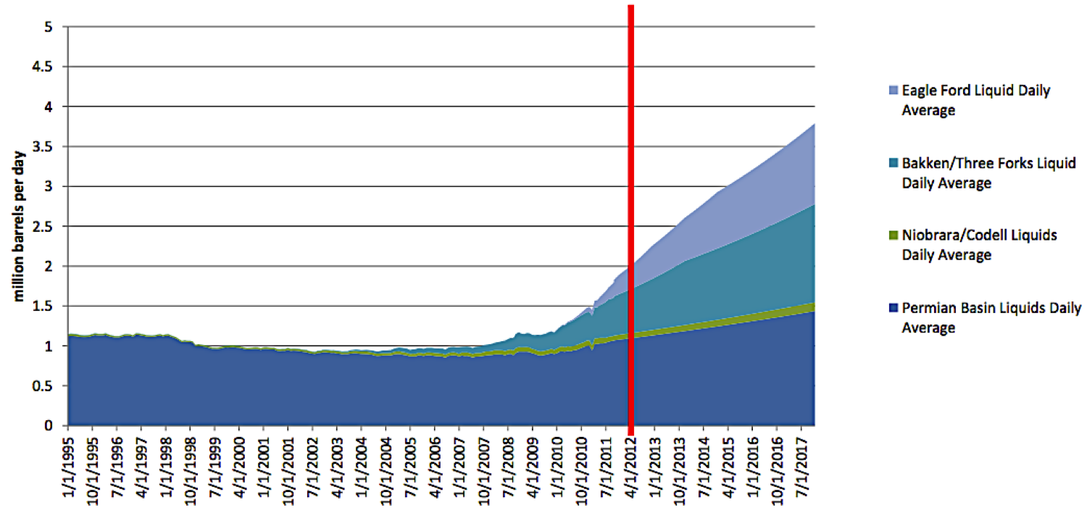
Near Term Outlook -- Unconventionals
Source: HDPI data, EPRINC estimates
Notes:
HDPI data, EPRINC estimates

Slide 16
Emerging Shift in Global Energy Axis
A Geopolitical Shift of energy balance of power Reduced U.S. Dependence on Middle Eastern Oil
Imports Now = 45% of US demand-
First decline in 40 years: .6% lower than 2010.
Saudi Arabia: ARAMCO- OPEC dominance already wanes because of massive reserves in U.S. and Canada. (November 2011)
OPEC estimates reserves of “unconventional” shale oil in North America could exceed 300 billion barrels
Saudi Arabia’s conventional reserves - 265 billion barrels

Slide 17
Economic and Energy Volatility
Remember Summer 2008
Sharply rising energy demand from China & India
Middle Eastern Instability – comparatively minor (Yemen/Nigeria)
U.S. Gas Prices Go to $4 gallon; Natural Gas is $11 mcf
Public Clamour for Increased US Offshore Oil Production
30 Year Congressional
Moratorium on Most Off-Shore Oil Production
Multiple Polls: 85% Support Repeal of Moratorium/Energy Independence!!!!!
A Crown Jewel of the Environmental Movement Falls 9/30/08– even with Pelosi and H. Reid!!!!!
Fall 2008 Bush Administration begins to open Offshore.
Barack Obama is elected President and immediately reverses direction.
Recession
Stimulus- $100-$200 billion for “Clean Energy” a la Solyndra and cousins.

Slide 18
Obama Administration Energy Policy
“We will end the tyranny of oil … as our parents ended the tyranny of Hitler.”
‘My energy policies won’t prohibit coal but will make coal-fired electric generation so expensive, the utilities will go bankrupt.”
“We need to get U.S. gasoline prices on the same level as in Europe”
(then $9-$10 per gallon). DOE Sec. Chu
Oil is a fuel of the last century.
“Drill, Drill, Drill “ is a bumper sticker not a solution.
We can’t drill our way to low gas prices when we have only 2% of world’s oil resources and consume 20% of the world’s oil.
Post Solyndra et al “We need to “double down” on clean energy” “that has never been more promising.”

Slide 19
Natural Gas
At the head of the pack in the fracking revolution.
Six years ago, large terminals at ports built to receive imported natural gas. Terminals now retrofitted to export the plentiful domestic gas.
Natural gas production 2006-2010- 48% average annual growth rate.
Shale gas now accounting for 25% of domestic natural gas production.
Many rich fields: Barnet Shale (TX,) Utica (NY, PA, WVA), Marcellus (OH) Haynesville-Bossier (LA), Fayetteville (AR) , Niobrara and other states.
EIA – Marcellus formation may contain more BTUs of energy than the oil reserves of Saudi Arabia.

Slide 20
Natural Gas (Cont.)
Uptake in production has led to glut-sharply declining prices
In 2008- Natural gas at $11 mbtu; In 2012 –Natural gas at $2 mbtu.
Low prices have revived US chemical industries and related manufacturing.
Natural gas had been viewed by activists and EPA as a bridge fuel to get beyond oil and coal.
Recently an about face, looks like the bridge may be regarded as a draw bridge.
Beware of making your competitor’s enemy your friend!

Slide 21
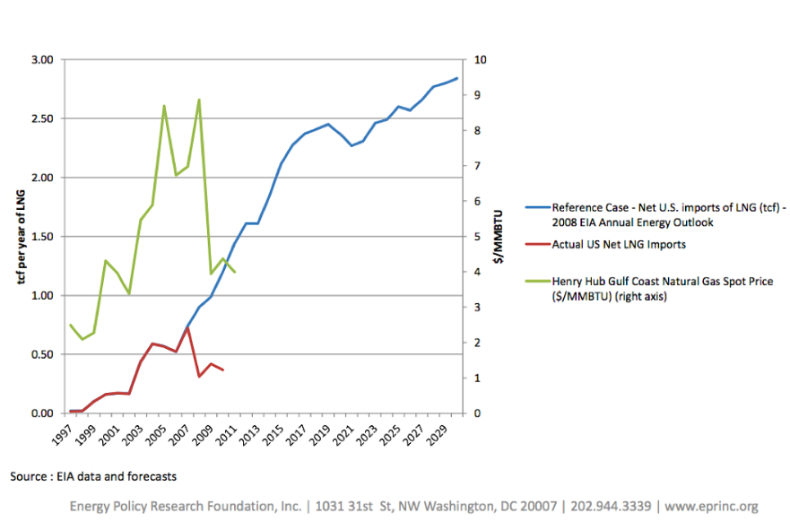
Projected Imports of LNG vs. Actual (or why forecasters should be humble)

Slide 22
Two Energy Policies =Two Economic Models
Solyndra versus the Mitchell/Hamm models
Venture Socialism v. Individual Entrepreneurs
I. Solyndra Model- Venture Socialism
Lavish Tax Payer Funded Subsidy to Create Green Jobs and “Jump Start” non-profitable renewable energy production.
Renewable Energy-inherently less reliable, less efficient, parasitic, far more expensive, unproven at scale.
Gov’t picking winners and losers. Solyndra one of many failures. In last 2 years of stimulus program over
$20 billion to renewable, esp. solar start-ups.
2011- federal subsidy for solar - $750 per kw hrr; for coal co.
Average $cost per job from stimulus subsidies = $10 million.
Result - Economic Pie Contracts

Slide 23
Two Energy Policies =Two Economic Models
II. Mitchell/Hamm Models
Risk-taking Entrepreneurs investing in development of innovative technology (Mitchell) and/or exploration and production (Hamm) within the competitive private market.
Mitchell-long time independent TX oilman, spent 10-15 years employing world’s experts to refine fracking/horizontal drilling=shale gas revolution.
Hamm-13th child of poor OK rural family. Began as roughneck in OK oilfields. Now CEO of Continental Resources. Credited with discovery of the Bakken Fields in ND and is biggest operator, self-made billionaire. His Individual effort is key to increase of ND jobs by 264% from 2005-2009 – without one dollar of tax-payer money.
Result-Economic pie grows.

Slide 24
U.S. COAL Reserves Dwarf Reserves of any Country in the World.
Now Coal Fuels 45% of US Electric Generation – recently 50%.
Coal long valued for price advantage and value as fuel for baseload power- key to affordable and reliable electricity
Wrongly Villified as “Dirty Coal”
Modern coal plants have multiple controls achieving huge reduction of air contaminants.
Coal is first on Activist’ and EPA’s hit list. Indeed an orchestrated campaign to kill coal.
*But will be exported to China et al and burned w/out environmental controls –
*(China -400 tpy/Hg; US -30 tpy/Hg23 tonss)
EPA proposed regulations (eg mercury rule) already led to multiple coal plant closures.
*Reliability is at stake this summer if high demand.
Natural Gas historically low prices a slight competitive advantage over coal., rapidly replacing coal for generation..
Coal a vital component of steel production and many other products.
If gasification technology matures, coal could yield feedstocks as varied as crude oil.

Slide 25
U.S. COAL Reserves Dwarf Reserves of any Country in the World.
EPA proposed regulations (e.g. mercury rule) already led to multiple coal plant closures.
Reliability is at stake this summer in certain areas if high demand. Texas reserve margin has fallen from 13-8%.
Natural Gas historically low prices a slight advantage over coal, rapidly replacing coal for generation?
The Value of Energy Diversity = competitive consumer price and resilience in market shocks.
Coal a vital component of steel production and many other products.
If gasification technology matures, coal could become a feedstock as varied as crude oil.
Energy Divesty= Energy Resilience

Slide 26
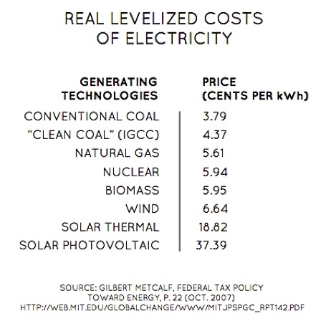

Slide 27
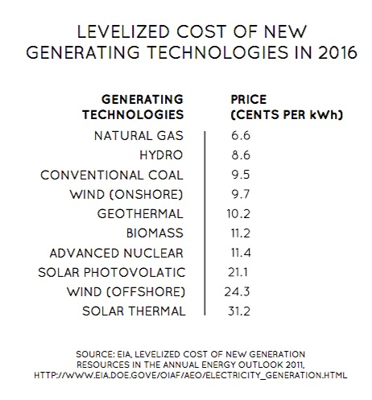

Slide 29
The Current Administration: Energy Policy Folly
First Energy Policies in US History w/ goal of raising the price of fossil-fuel based energy
A War on Fossil Fuel Energy Sources Providing 85% of US Energy.
But No Viable Alternatives for Deployment at Scale.
No Viable Alternative Now with the Abundance, Affordability, Reliability, Efficiency, Density of Fossil Fuels
Rationale- If conventional energy from fossil fuels is more expensive, then far more expensive, unreliable, inefficient renewable energy (wind/solar) will be more competitive or socially tolerated.
European Union already implemented this policy and miserably failed.
EU retracting pulling back from clean energy subsidies and feed-in tariffs.
After aggressive renewabl use, Germany- Over 500,000 homes with no electricity.
Regressive Impacts already felt: US Energy costs now higher than food.

Slide 30
And Whence the High Gasoline Prices?
Multiple and Complex Variables but widely misunderstood dynamic
Globally Set Price of Crude Oil drives the price of gasoline-76% based on price of oil
He with the most black gold rules= OPEC, esp. Saudi Arabia-greatest reserve capacity.
Oil is priced in U.S. Dollars- Weakened dollar increases oil prices (NB QE1 & 2, National Debt, Credit Downgrade)
Rest of gas price- federal and state taxes, oil refining costs, distribution, profit. Federal tax is $18.4 cents; State taxes vary.
Supply and Demand of Course Prevail Anticipation of Increased or Decreased Supply major determinant.
Most so-called speculators are investors - airlines locking in jet fuel price helps consumers
U.S. Export to Latin America of limited petroleum products has not driven gasoline price up

Slide 31
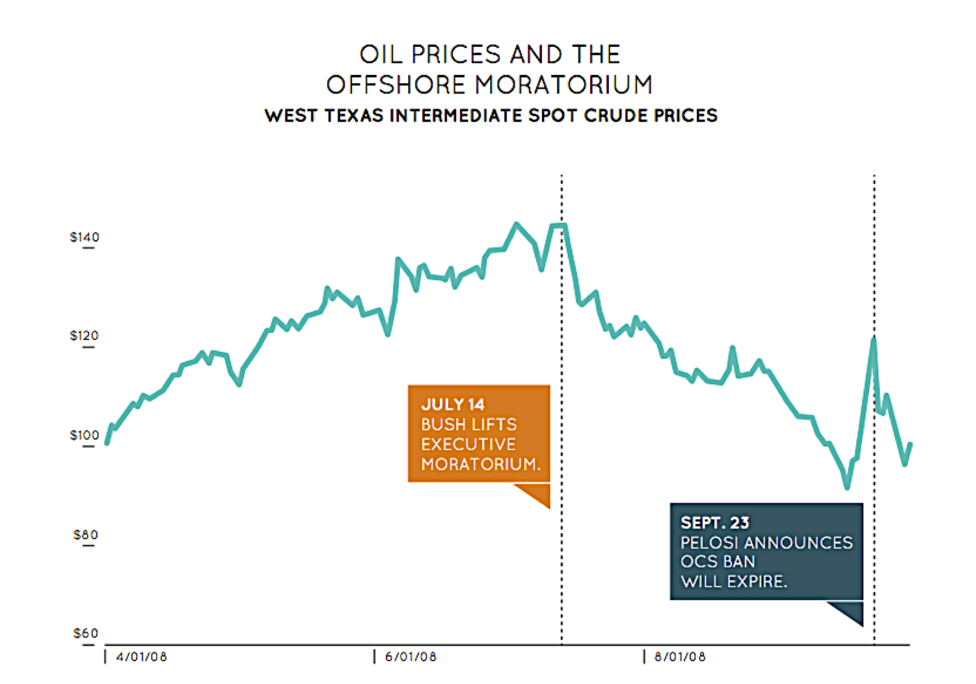
Offshore Drilling and the Price of Oil

Slide 32
Growing Political Turmoil and Instability in Middle East still a Major Factor.
Current price rise began when Libyan turmoil removed 1.5 mbd off the market.
Increasing regional instability followed – risk of closure of the Straights of Hormuz
Escalating tension between Israel and Iran.
Iran production falling as result of sanctions.
Saudi Arabia’s (the OPEC kingpin) reserve capacity declining
Saudi domestic oil consumption rising and energy-driven welfare state limiting Saudi investment in energy.
Geo-political dominance as the swing supplier in time of unrest or increased demand?
U.S. Policy Action such as denial Keystone XL pipeline project lowers expectation of US domestic supply.

Slide 33
Keystone XL Pipeline et al Needed Infrastructure
Keystone XL – 3 years and 8 volumes of permits ... final approval
Then EPA “weighed in” on the carbon footprint
Urgently needed to break bottlenecks in North Dakota and Cushing, OK
Gulf Coast Refineries invested $$$billions to reconfigure for Canadian oil
Summer 2012 closure of old but key eastern refineries
Denial of Keystone – a factor in rising oil prices

Slide 34
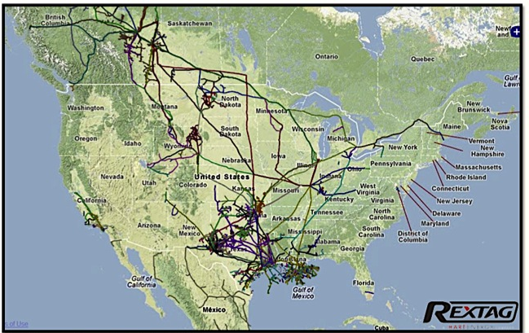
North American Crude Oil Pipelines
Source: GeoWeb Portal Rextag Hart Energy Mapping Service Feb 13 2012

Slide 35
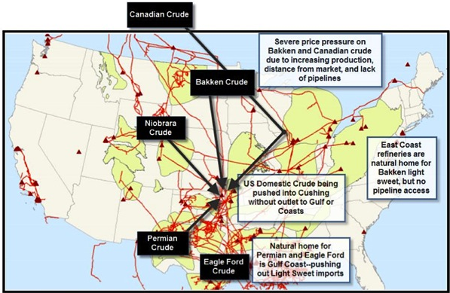
Choke Points
Source: Savage, Presentation Bakken Product Markets and Take-Away Denver Jan 31-Feb 1 2012 with EPRINC Additions

Slide 36
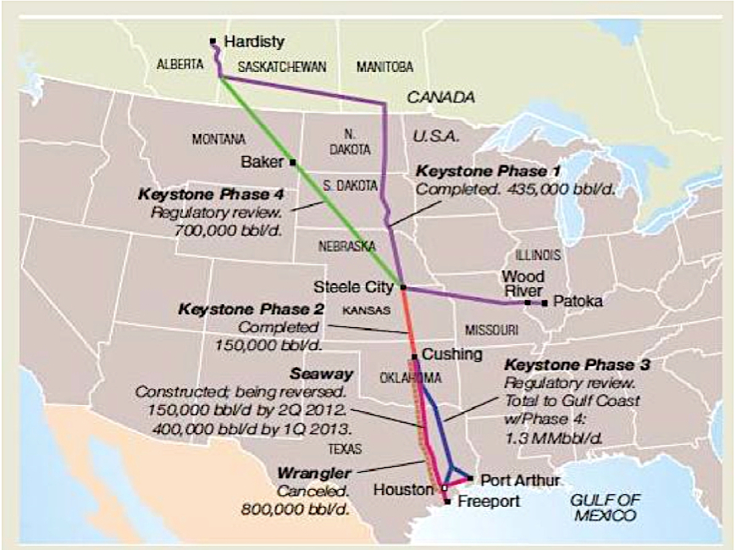
North American Pipes
Source: Energy Policy Research Foundation, Inc.

Slide 37
The North Dakota Story 2005 -2009 Economic Miracles Do Occur
From 2005-2009 ND increased employment by 264%. Oil Business increased economic value from $1.3 billion to $5 billion.
Service businesses and related jobs =$12.9 billion
Income per capita increased by 78%
Paid $559 million in leases and royalties to landowners Paid $821 billion in taxes
Unemployment rate of 3.5 % - lowest in the U.S. Midland, TX now tied with Bismark, ND!
Likely negative unemployment-with 18,000 jobs unfilled
Sources:
North Dakota State University Report (www.ndiol.org)
“How North Dakota Became Saudi Arabia,” Stephen Moore, WSJ, 10/1/2011

Slide 38
96% of Increased Production Feds Constrains Production on federal lands and offshore (OCS)
Upsurge is on Private and State Lands

Slide 39
Onshore Federal Lands
Restricted 4 decades – Now Suppressed
Leases on less than 6% of federal lands
Federal/Indian Lands – 31% of total US oil production in 2011 (36% in 2010)
Similar figures for natural gas
Upsurge in production 96% from private and state lands.
Magnitude of Upsurge (1.3 mbo increase 2008-2001) masked by decline on federal onshore and offshore lands under Obama administration.
BLM data since 2009:
New federal oil and gas leases down 44% from 2007-2008 levels.
Permits to Drill down 39%
# of new wells drilled down 39%
Return to production levels 2007-2008 = an additional 7-13 mbo

Slide 40
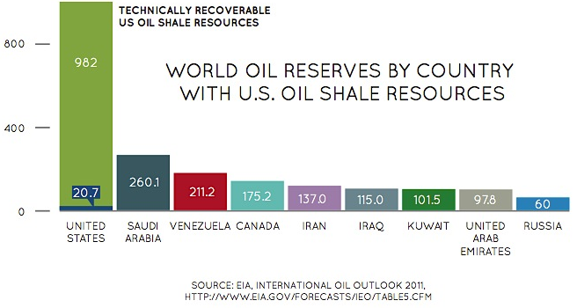

Slide 41
Oil Shale- The U.S. Mother Load

Slide 42
Alaska A State but Almost All Land Federally Owned Vast Untapped Resources
ANWR- 19 million Acre Reserve Created in 1980
Oil production planned for only 2000 acres – 0.01% of ANWR
USGS estimate of over 16 bbo – development blocked 30 years
Caribou population: 1968-6,000; 2009-67,000 re Prudhoe Bay
National Petroleum Reserve- 15 bbo
Beaufort & Chukchi Seas- 30 bbo
Shell spent 5 years and $4 billion seeking permits in Beaufort
Trans-Canada Pipeline deteriorating with decreased production

Slide 43
Offshore
Federal government controls oil and gas leasing on the Outer Continental Shelf
DOI estimates OCS contains 86 bbo/ 420 tcf natural gas
97% OCS not leased; Moratorium on most OCS leasing began 1982
Remember Drill Here, Drill Now Campaign
Congress repeals moratorium in September 2008 . President GW Bush initiated lease process: Halted in January 2009
Gulf production -2010 oil spill– 31% US production pre-spill
After BP’s Macondo oil spill – federal moratorium then permitorium on shallow/deep wells.
Lost 200,000 bo from Gulf in 2011; 700,000 bo by 2020.
Yet, Obama engineered multi-billion IMF financing for Brazil’s offshore.

Slide 44
Real Energy Jobs
Since 2003, jobs in the oil and gas sector have increased 80% : Bureau of Labor Statistics
20%- 1 in 5- of all new net jobs created.
Average salary in the oil and gas sector $60,000-$80,000
Median Annual U.S. Income (family of four) = $49,700
Woods MacKenzie : U.S. energy boom creation of 1.4 million new jobs by 2020
Jobs would increase govt. revenue by $800 billion.
E.g. Texas- Over the last 2 years, oil and gas production jobs increased 16-20% - highest annual growth rate by sector.
Indirect jobs/service companies, petrochemical industries, manufacturing

Slide 45
Suppressing US Energy- Nothing New
“Environmental Policy Constraints on U.S. Oil Supply: Outdated & Unjustified” KH White, TPPF, August 2008.
“Since the early 1970’s, policies driven by a now-entrenched environmental establishment have restricted exploration and production of domestic oil and gas. The policies are now outdated, unrealistic and overwhelmed by the needs of national security and economic stability.”
Over 150 Federal laws enable suppression of oil, natural gas, coal, uranium and other mineral production. Citizen Law Suits Used Constantly by Environmental Activists.
“CO2 is today’s elephant in the energy arena, paralyzing policy to increase domestic oil and gas production.”

Slide 46
We Can Be Makers Again!
Upsurge already Supporting Revival in Manufacturing
Ohio building new steel plant to make fracking hardware
Philadelphia Shipyard site of oil tanker construction
U.S. Chemical Industries Resurgent with low natural gas prices
*$2 billion Shell plant near Pittsburg
*$4 billion Dow expansion in Texas
NO STIMULUS PLANS NEEDED!
U.S. oil and gas sector grew 4.5% in 2011
Twice as fast as U.S. GDP at still anemic 1.7%

Slide 47
And the Renewables….
With Massive Subsidy…..still far more expensive than conventional
2011 Federal= $775.64 for solar per MWh v. $0.64 for coal and natural gas
2011- Wind generated 1.2% of total electricity used
Solar generated 0.01% of total electricity used (EIA numbers)
Unreliable
Intermittent source not capable of baseload/peak electric generation
Not capable of scale- powering large city at peak demand.
Parasitic on conventional fuels for back-up
Like idling one car while you drive another car-wasteful
Larger carbon footprint?
100,000 acres of solar panels wind turbines to generate several hundred MW
Off-shore wind more efficient
Market dynamics would take renewable to useful niche

Slide 48
Renewables Cont.
Common slight of hand among renewable advocates
Always remember difference between installed capacity and capacity factor
Installed capacity- amount of electric power (MW) of EGU running 24/7
Capacity Factor- actual (averaged) (used) generation
Texas has 10,000 MW plus installed capacity
Texas Grid Operator (ERCOT) calculates less than 8-10% capacity factor.
Thus, the 10,000 MW installed yields less than 1000 MW generation.
Renewable Energy promoters typically use the inflated #’s in installed capacity.

Slide 49
“A Liberal Mugged by Math and Physics”
“Power Hungry: The Myths of Green Energy and the Real Fuels of the Future.”
Author and Renewable Critic , Robert Bryce

Slide 50
Air Quality Improvement 1980-2010
Source: EPA’s “Our Nation’s Air: Conditions and Trends”

Slide 51
Now Have Elaborate Technology Can Assure Safety and Environmental Soundness
Over 40 years, private sector has developed elaborate technology and operational methods to dramatically reduce environmental impacts of producing and processing fossil fuels.
Industry now knows how to produce with maximum care and control … not the case 30-40 years ago
The dizzying pace and increased volume of production merit increased regulatory oversight
Crucial that Existing State and Regional Regulatory Authority is maintained.
Administration’s Plans for new EPA regulation will not optimize environmental safety.
Upstream oil and gas production historically has not been viewed a source of major emissions or contaminants.
States have primary regulatory authority on upstream production but federalizing Underway

Slide 52
Energy Independence ? Energy Securities? Energy Axis? Energy Resilience? Energy Realism ?
After 40-year steady decline in US production and increasing imports, US production is sharply rising.
Foreign imports once accounted for over 60% of US demand.
Now below 50% imports and falling.
Six U.S. Presidents unsuccessfully promised Energy Independence. Forty years of law and regulation restricting or blocking access to US energy resources.
147 environmental laws blocking access to US energy.
In spite of the federal shackles, the U.S. on track to become a net exporter of O&G.
In spite of federal policy – 100% driven by private sector initiatives.
Many analysts predict US could become world’s largest producer by 2017
Canada a natural partner

Slide 53
The U.S. Energy Path
The Stakes:
Economic Growth
Income Per Capita growth
Return of US Competiveness in Manufacturing
Solid Jobs
Increased Gov. Revenues
Reduce Crippling National Debt
Geo-Political Strength
Energy Security
W/ Cutting edge Environmental Technology
Unless CO2 alarms you … a long but simple story!

