Slide 1

Values Foundation of the
Texas Identity
2024
VALUES RESEARCH REPORT

Slide 2

ABOUT THE STUDY
Introduction 3
PART 1
Values by segment 7
PART 2
Contrasting segments 23
PART 3
A values framework for strategies 27
Values Foundation of the Texas Identity is a study that maps the values-based attitudes, insights, and opinions of four segments of Texans as they relate to their identity as Texans. The resulting findings,, obtained from sixty respondents across the four segments, uncovers the unique values driving connection and identification as a Texan.
We look at the connections both native and new Texans hold with their state, finding some commonalities and other distinguishing features that shed new light on the state’s connection with its newest citizens.

Slide 3
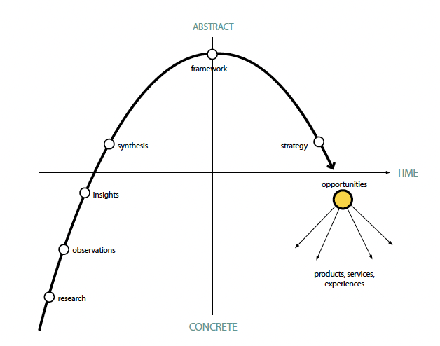
INTRO
VALUES BY SEGMENT
VALUES BY SEGMENT
Values laddering research process
PART 3
PART 2
NEXT
PART 1

Slide 4
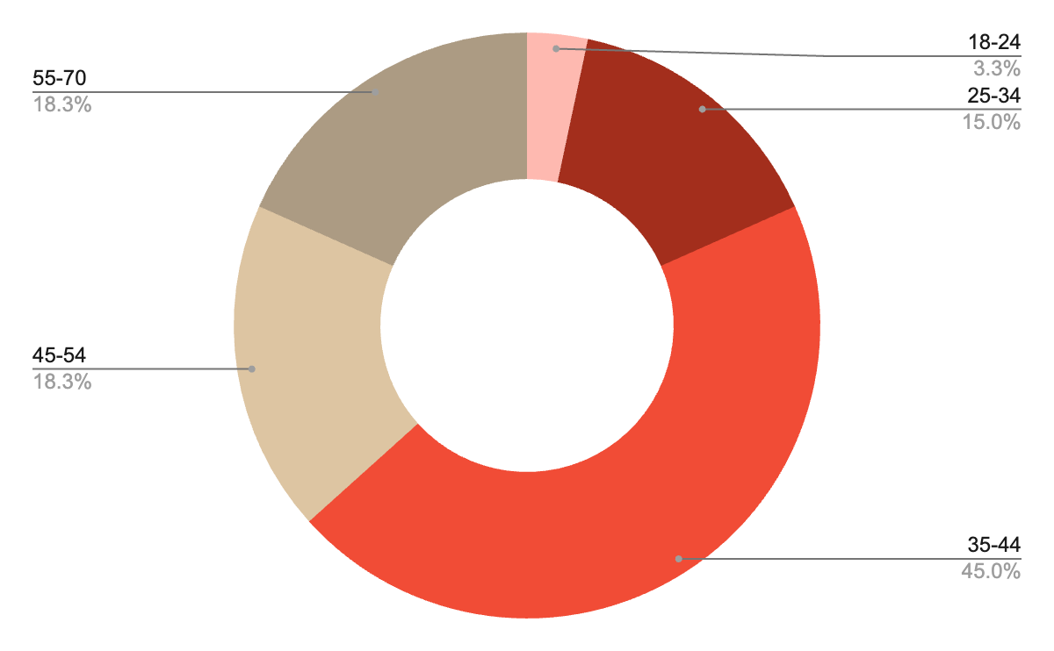
A closer look at the study segments
UNSURE
MEN
WOMEN
TRUMP
HARRIS
Specifically, Hispanic/Latino of Mexican ethnic origin
The study recruited only Muslims and Hindus for the South Asian segment
MEXICAN A.
AFRICAN A.
S. ASIAN A.
MUSLIM
HINDU
New Texans are defined as anyone who moved to Texas after Jan. 1, 2009
NEW TEXAN
Age distribution of respondents across entire study
MEN (N = 25)
TRUMP VOTERS (N = 29)
WOMEN (N = 35)
HARRIS VOTERS (N = 26)
MUSLIM (N = 6)
UNSURE (N = 5)
HINDU (N = 9)

Slide 5
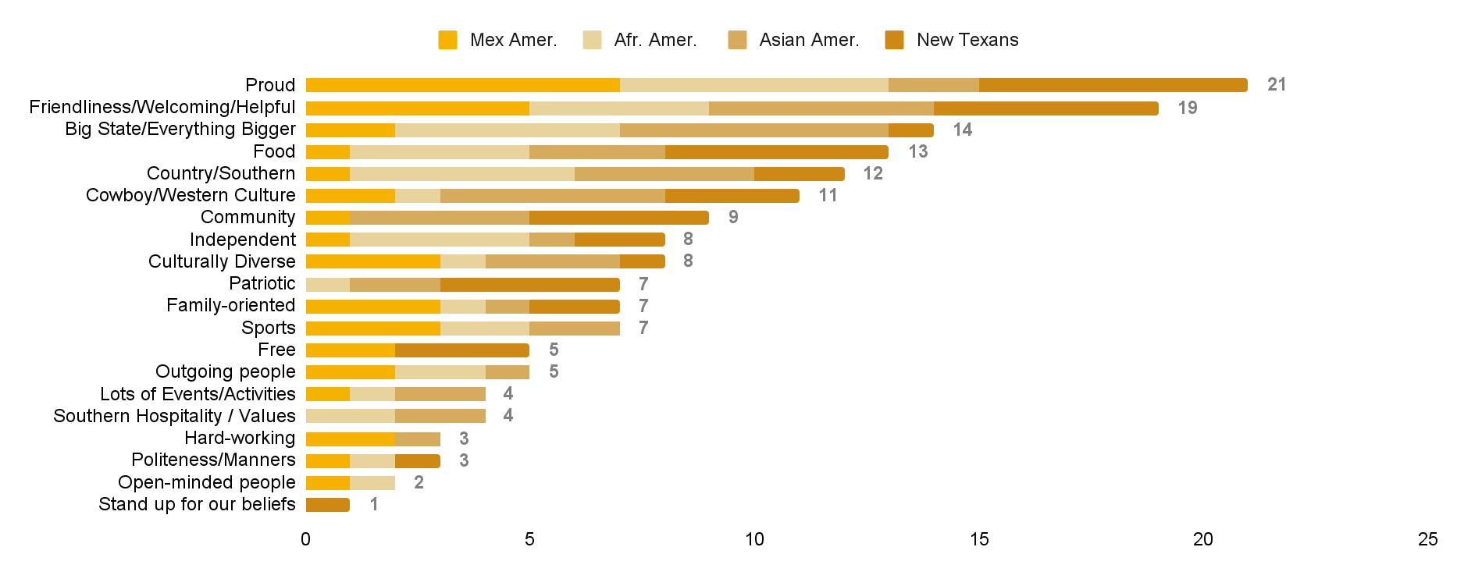
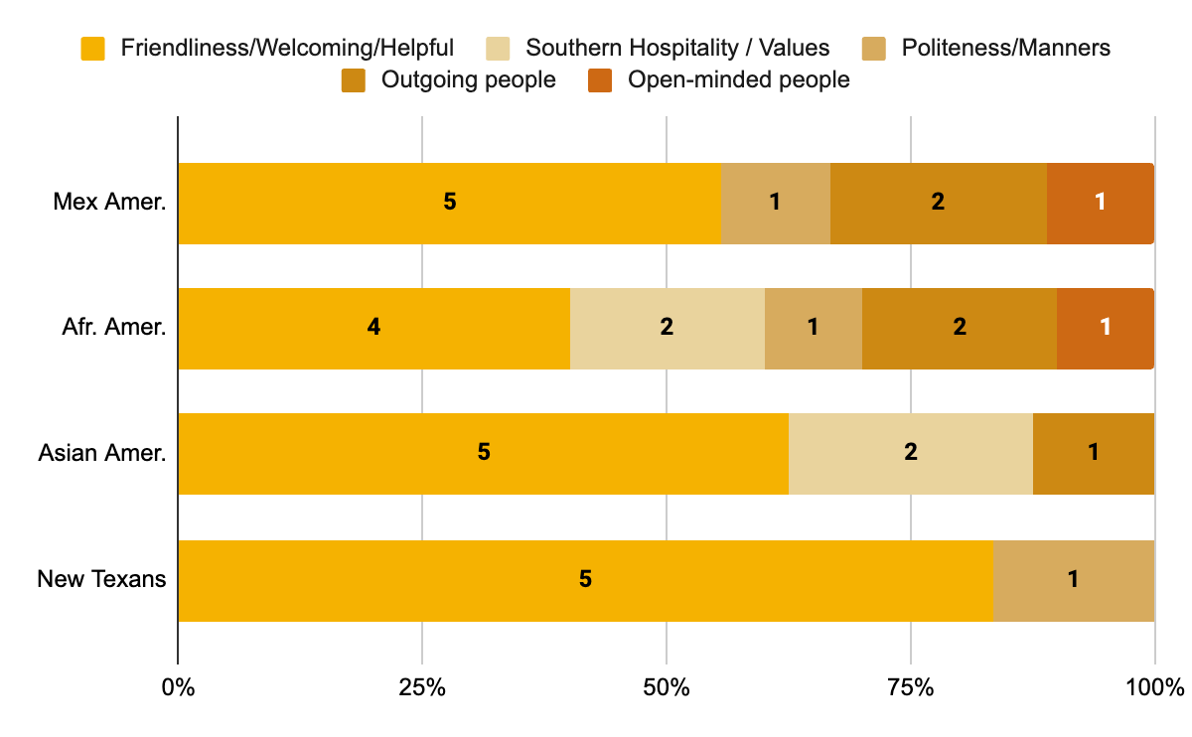
“How would you describe being Texan?”
Frequency of attributes related to Texas character and manners

Slide 6
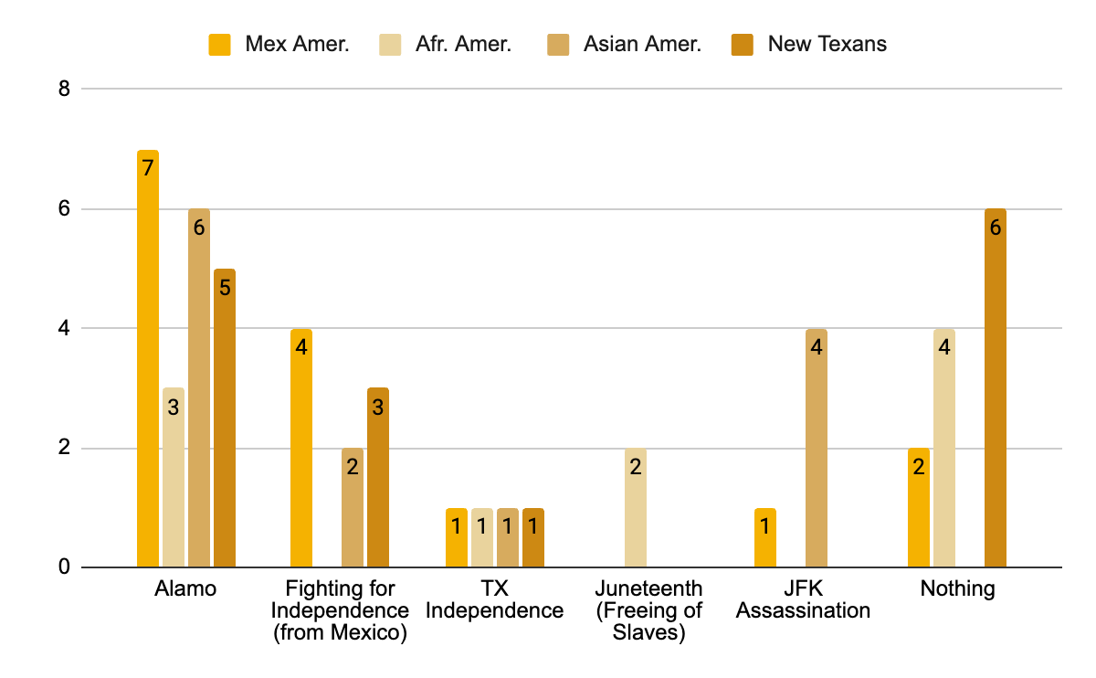
“Are there any parts of Texas history that are personally meaningful to you, or that you really identify with?”

Slide 7
PART 1
VALUES BY SEGMENT
VALUES BY SEGMENT
The Texas Identity resonates with three common deep values held by our three ethnic segments and the New Texan segment.
Two additional values, “family” and “pride,” are not present in the New Texan segment. The New Texan segment exhibits Exuberance of Freedom, which the native Texan segments do not.
Altogether, six values work together to explain the essence of how Texans today are relating to the Texas Identity in a modern way.
PART 1

Slide 8
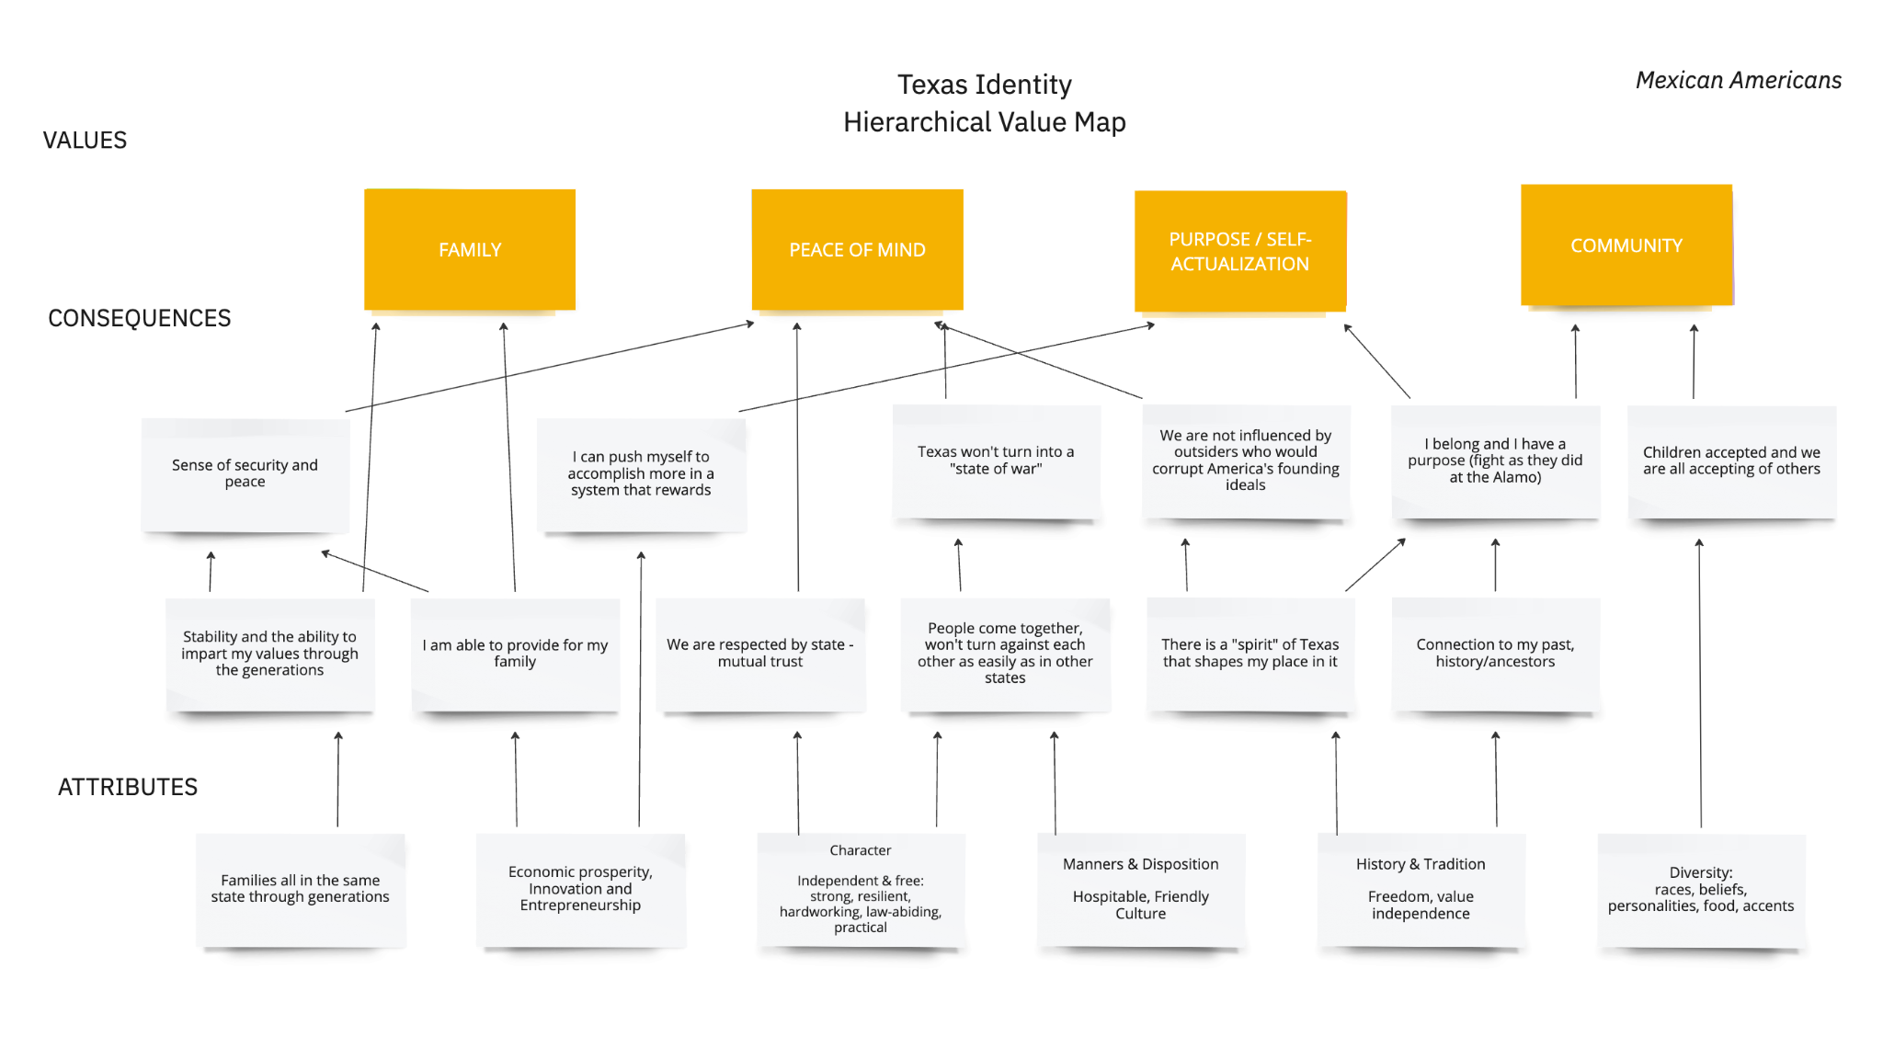

Slide 9
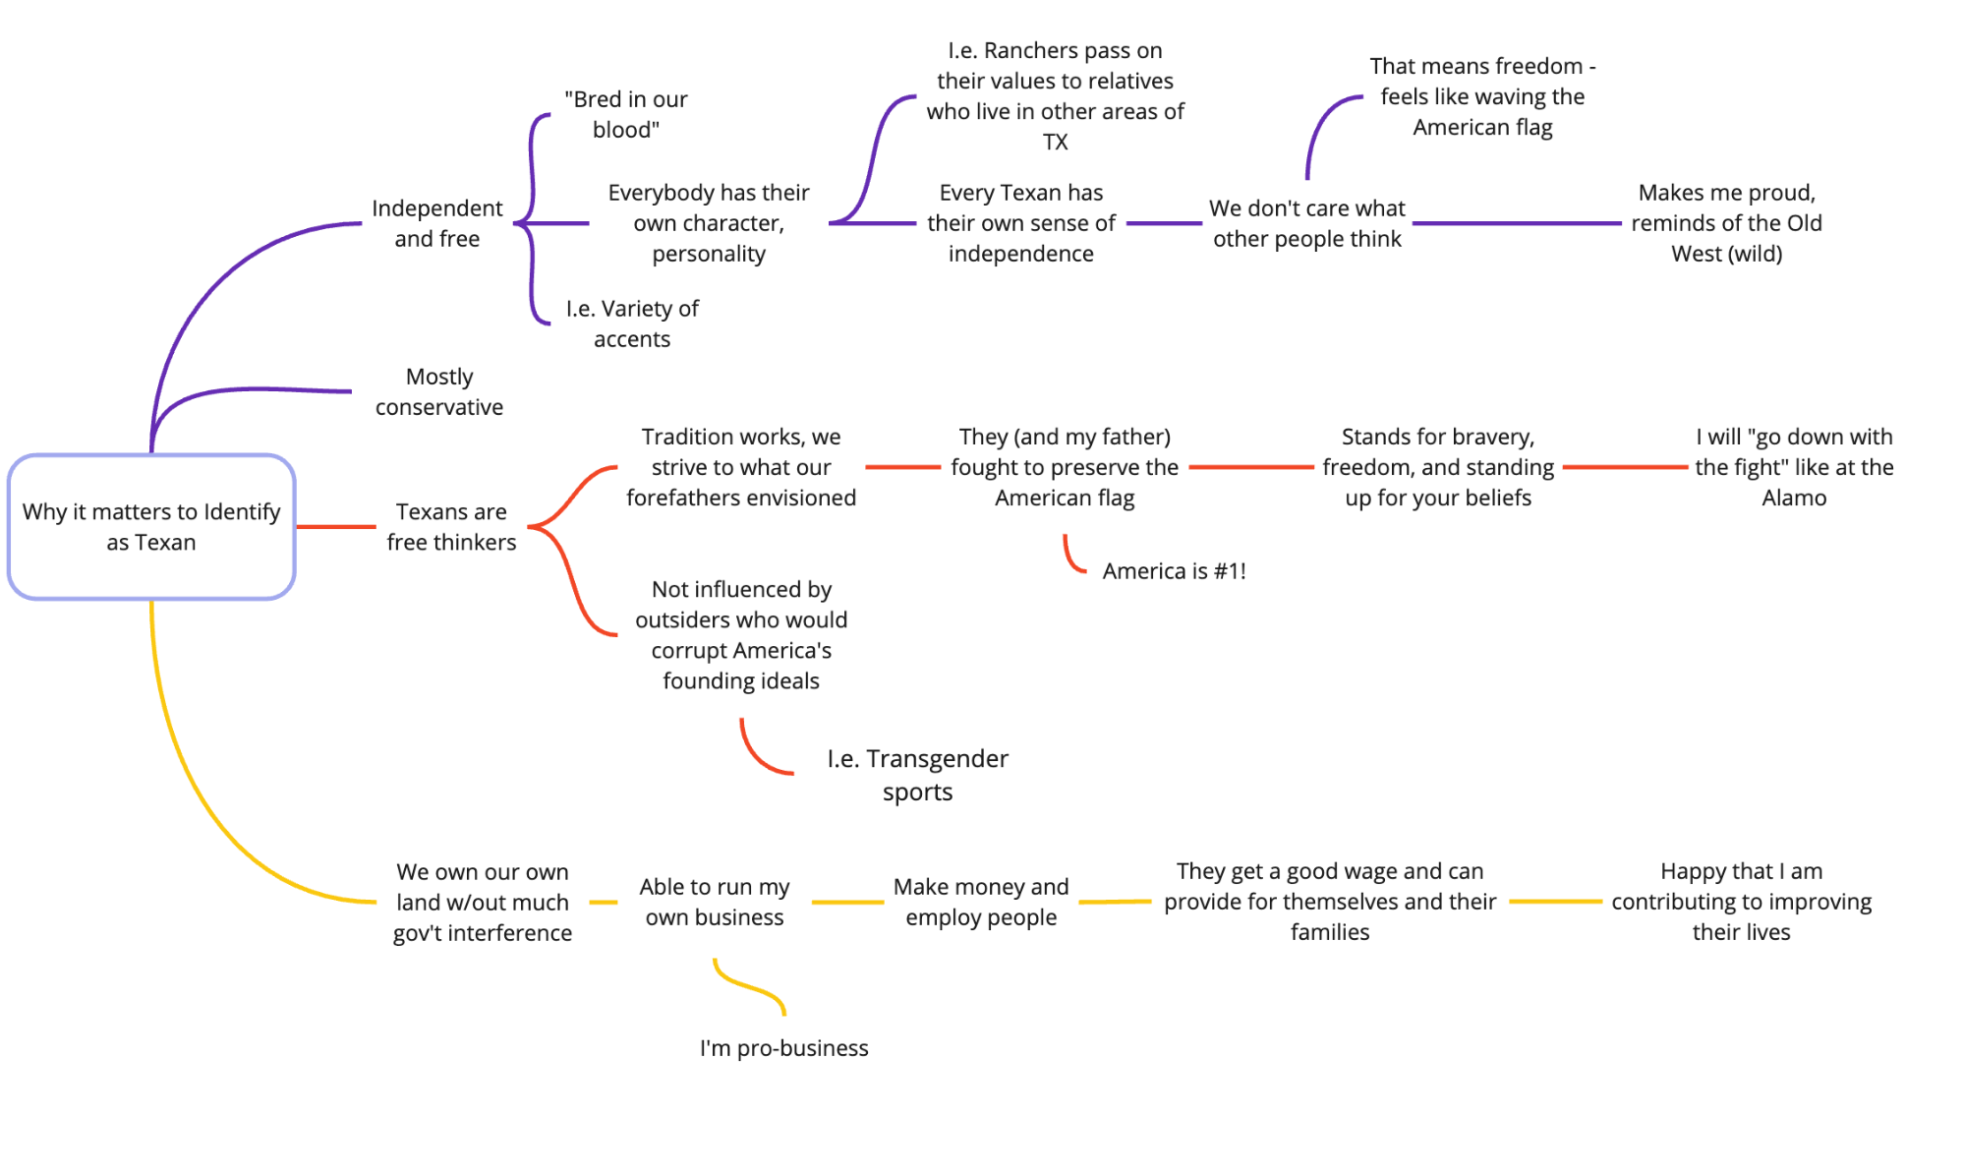
MEXICAN Am’s
“
Texans are free thinkers. Tradition works, we strive to what our forefathers envisioned. They (and my father) fought to preserve the American flag…
I will ‘go down with the fight’ like at the Alamo.”
Robert R., Mexican American

Slide 10
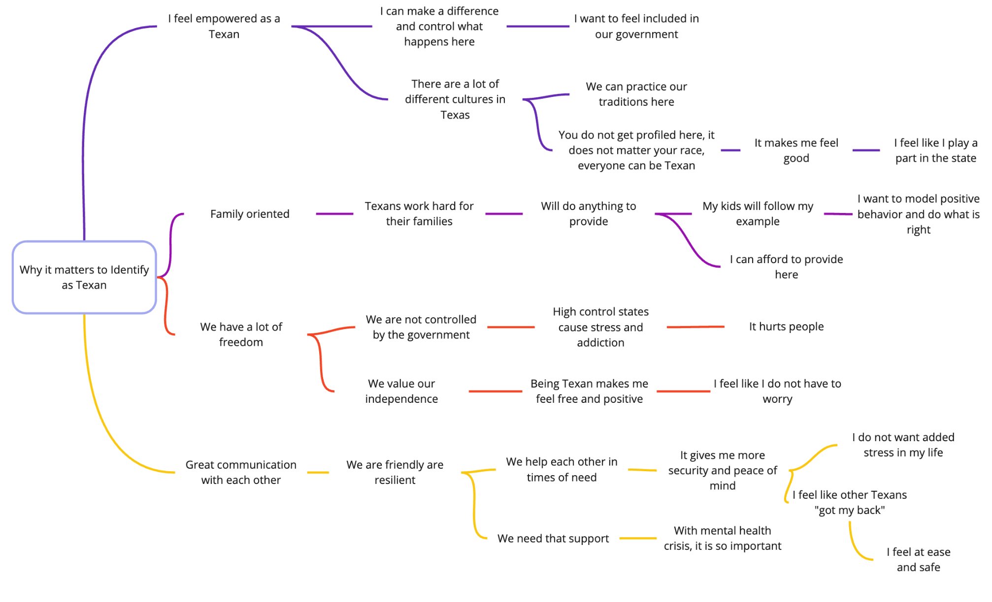
“
We have a lot of freedom, we are not controlled by the government. Being Texan makes me feel free and positive - I do not have to worry.”
David C., Mexican American

Slide 11
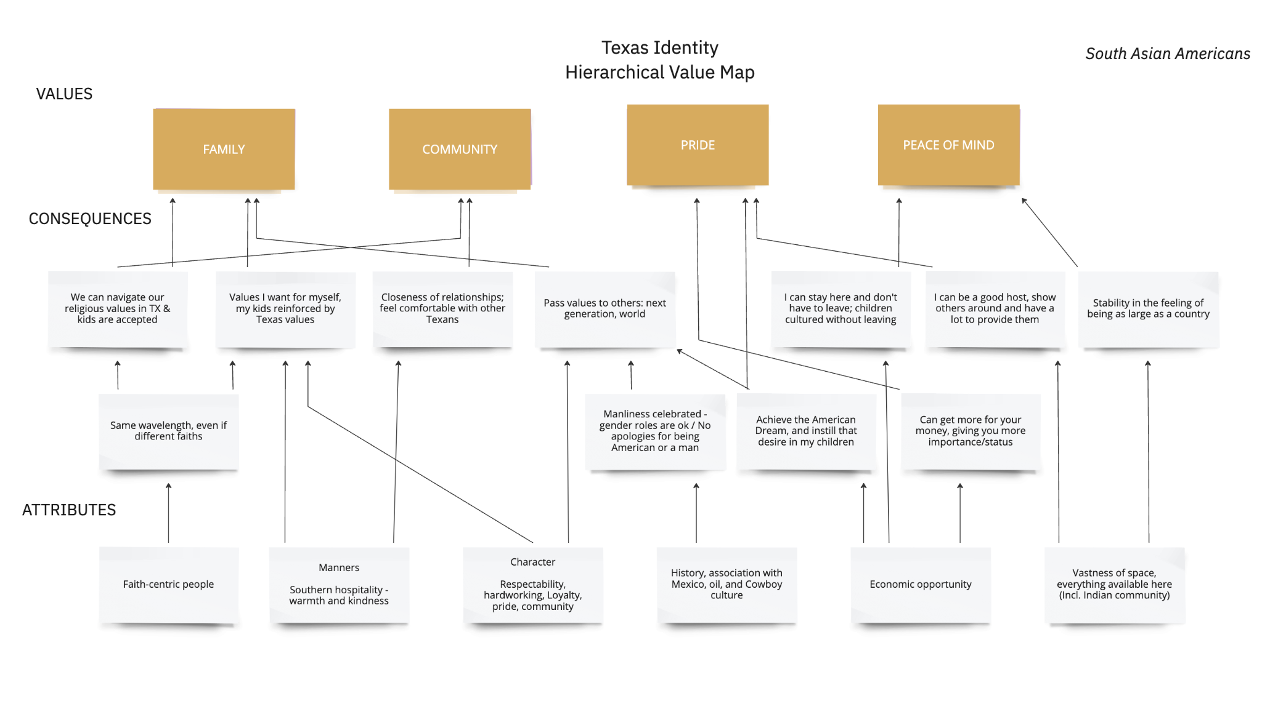

Slide 12
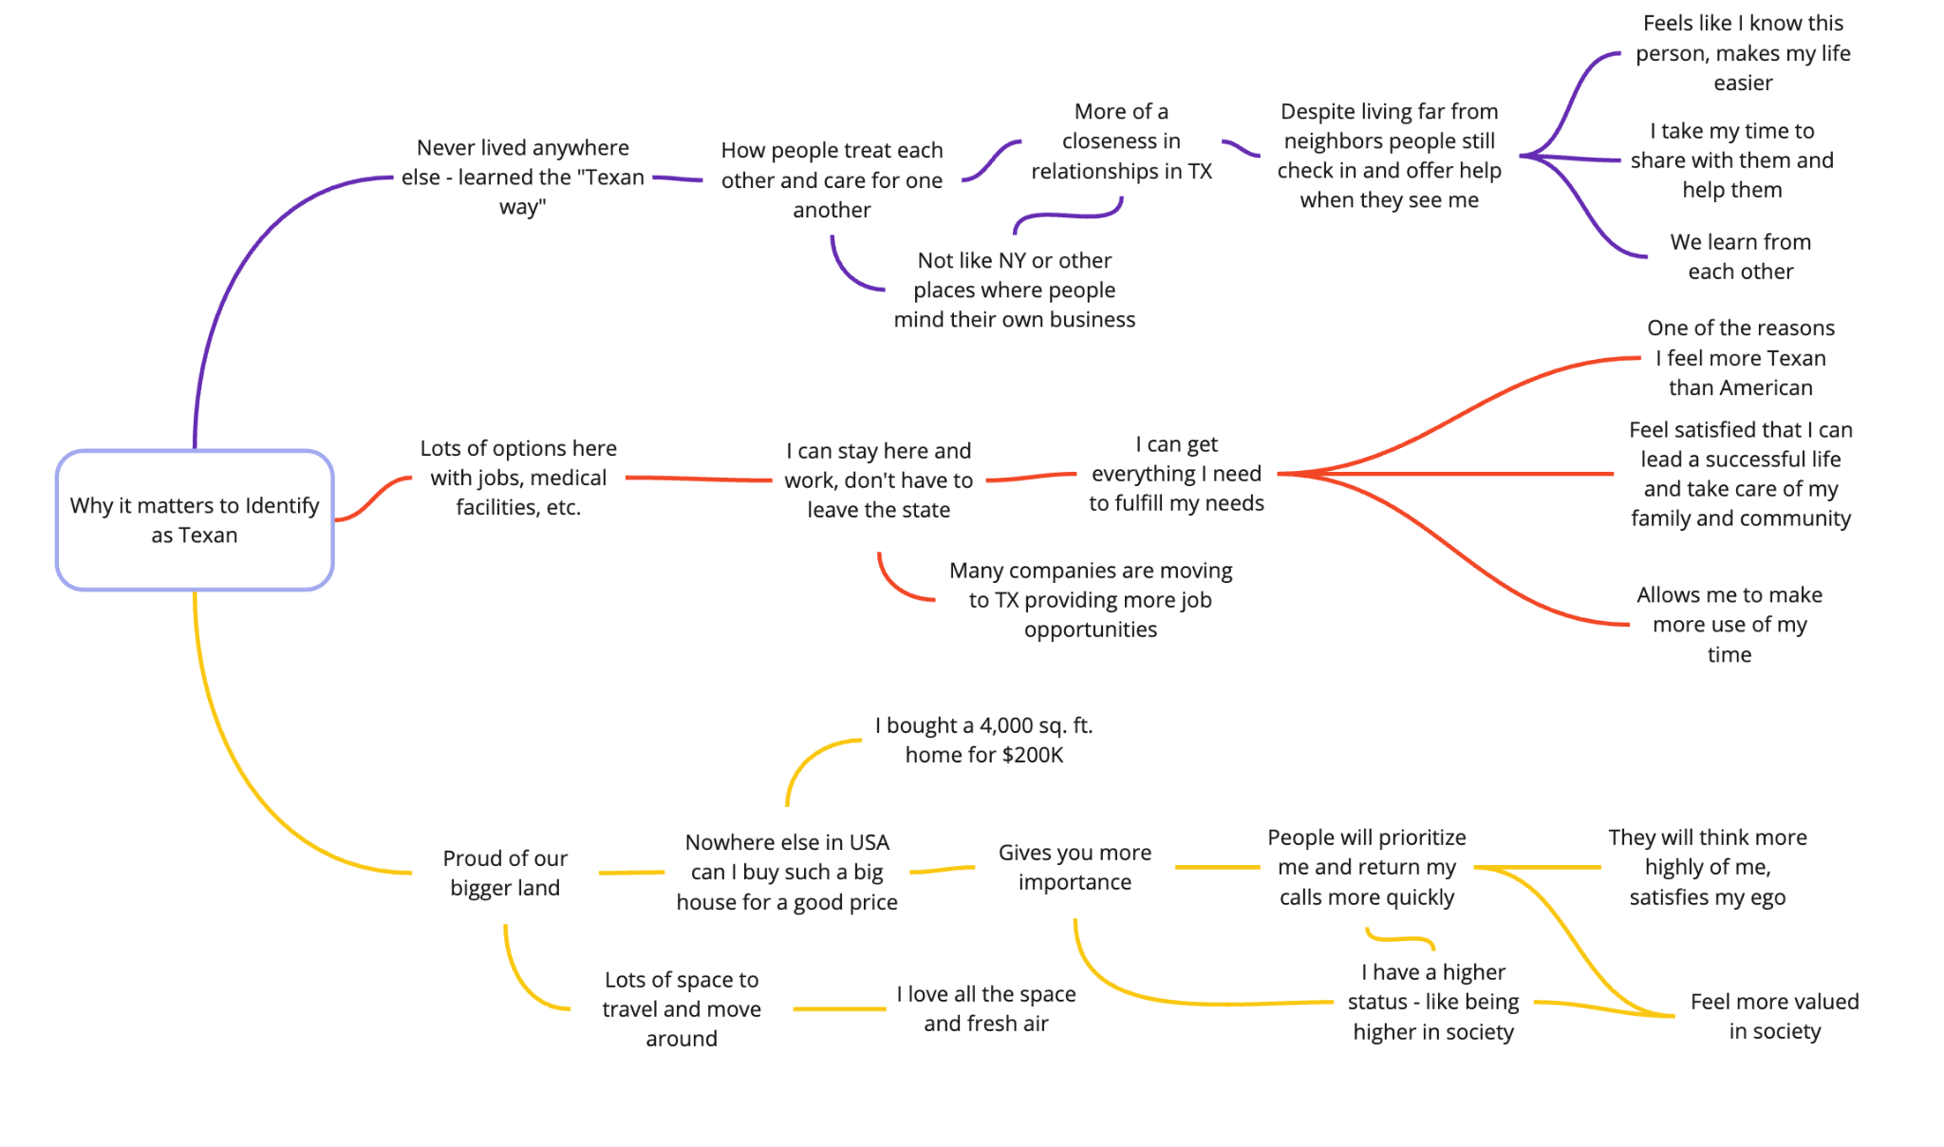
SOUTH ASIAN Am’s
“
Nowhere else in the USA can I buy such a big house for a good price. It gives you more importance. I have a higher status - like being higher in society.”
Alex J., South Asian American

Slide 13
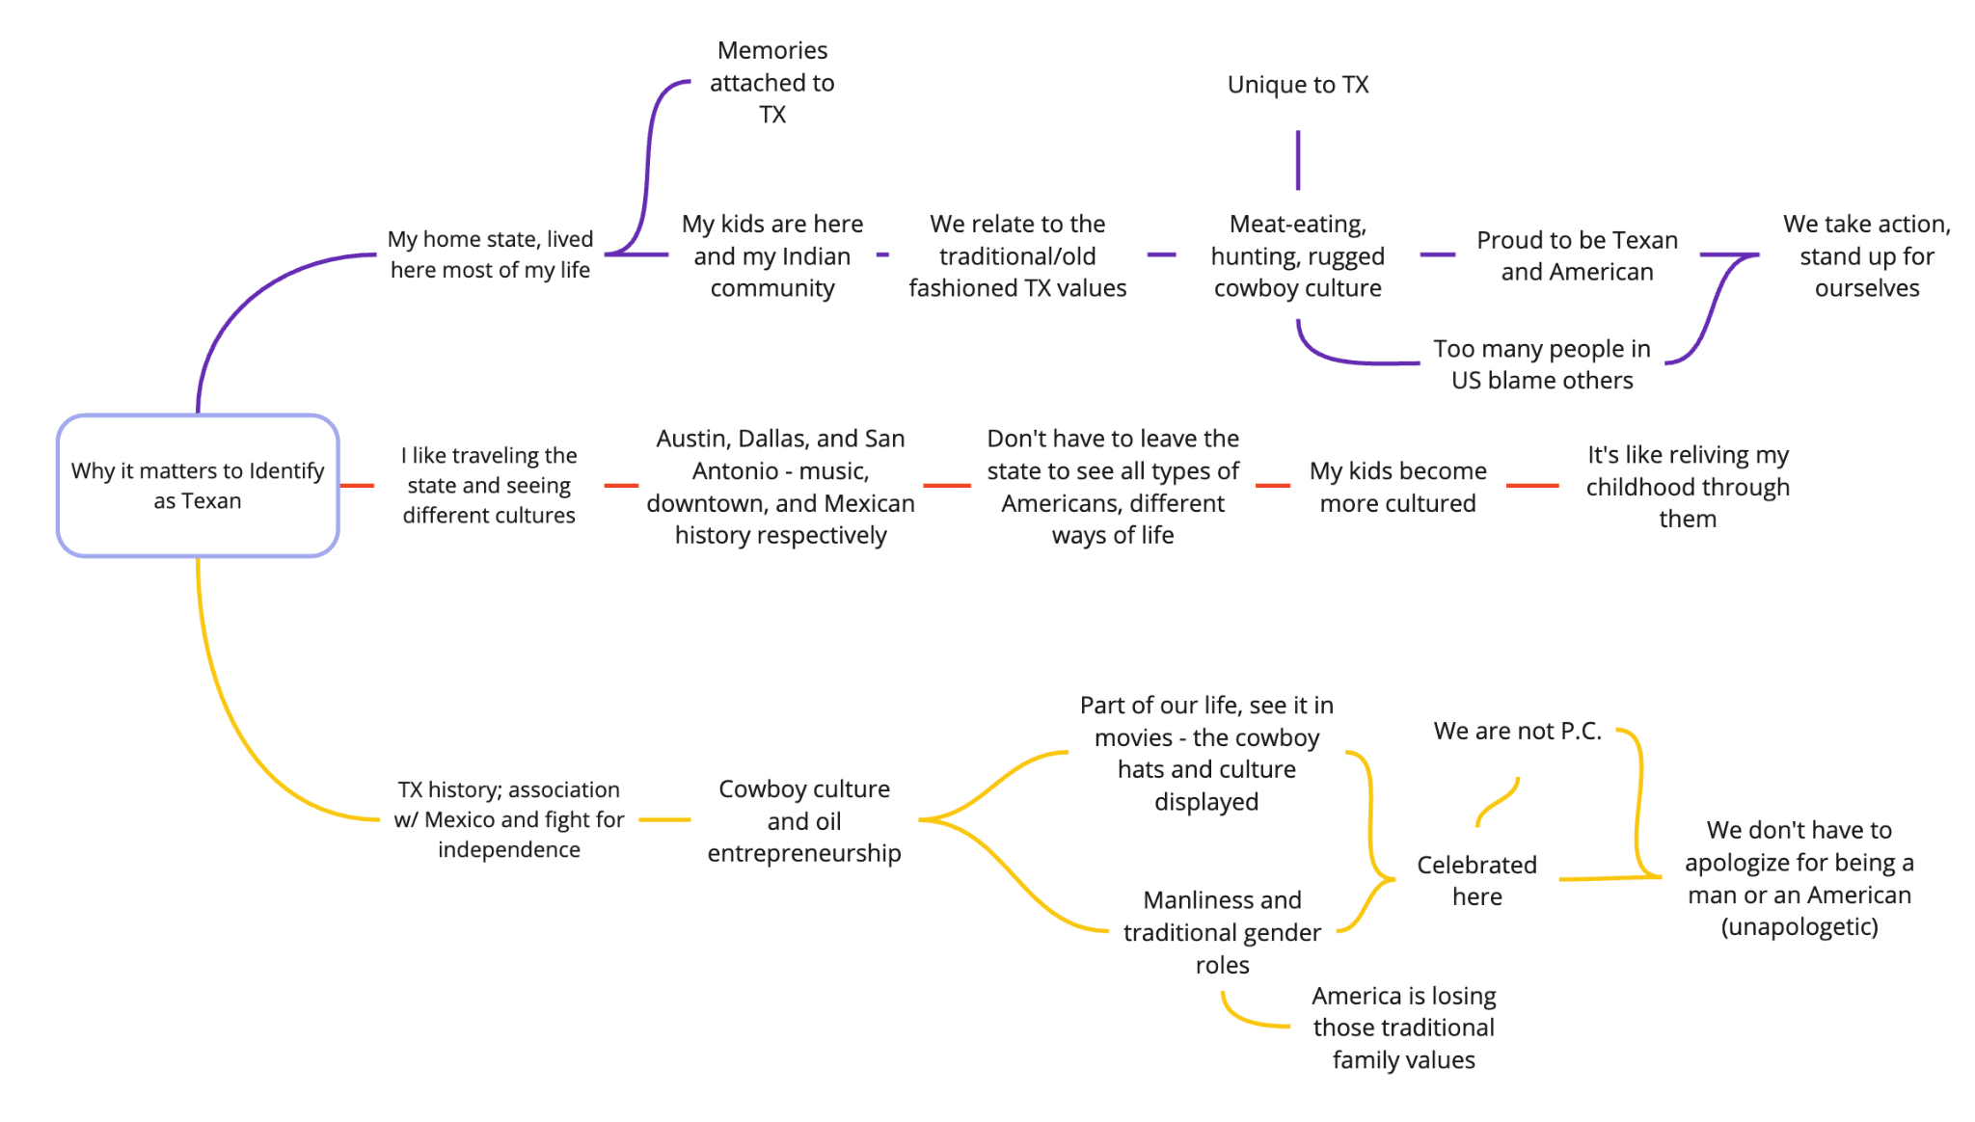
SOUTH ASIAN Am’s
“
Texas history and association with Mexico and the fight for independence, cowboy culture and oil entrepreneurship – [it all affirms] manliness and traditional gender roles. America is losing those traditional family values.”
Ash S., South Asian American

Slide 14
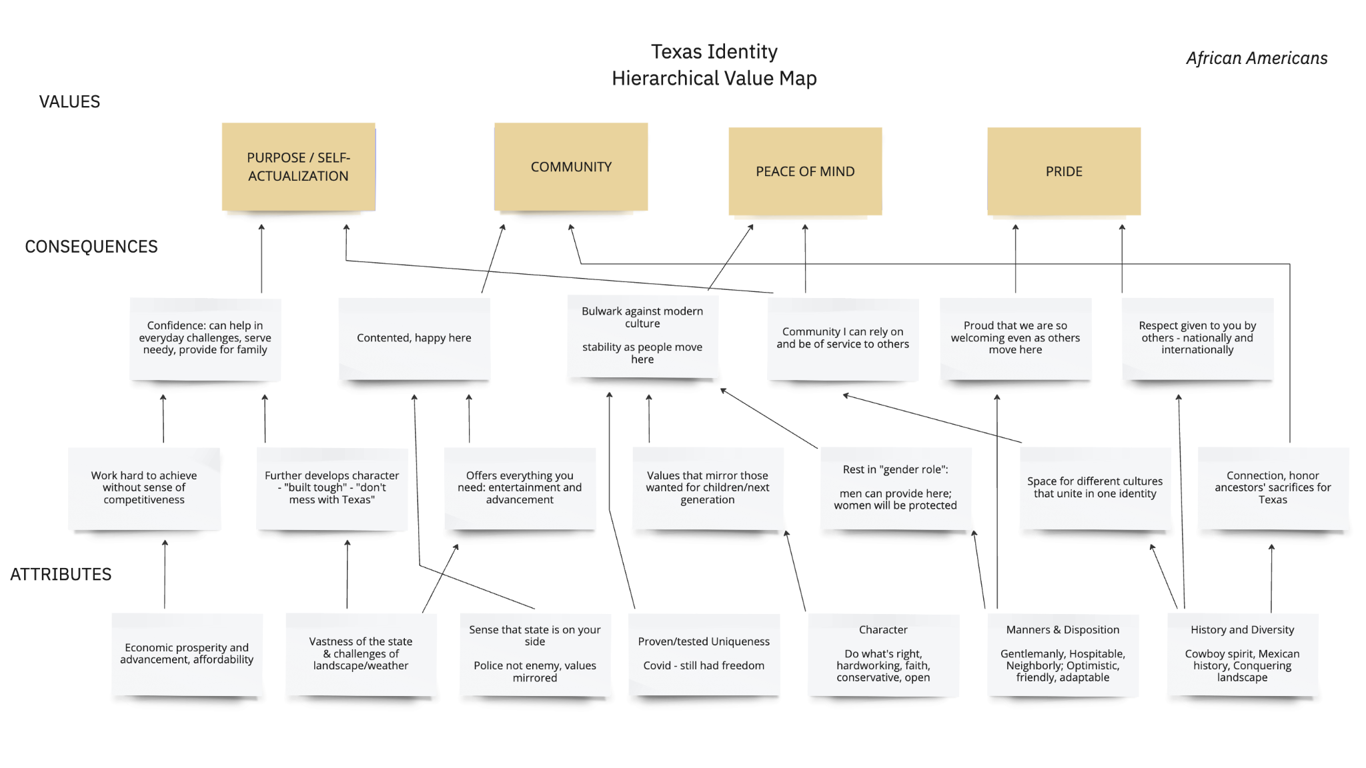

Slide 15
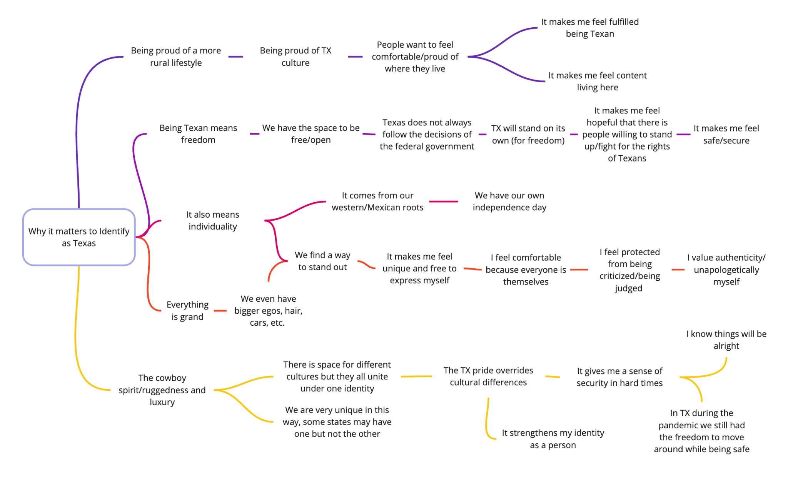
AFRICAN Am’s
“
There is space for different cultures but they all unite under one identity. The Texas pride overrides cultural differences.”
Fabian J., African American

Slide 16
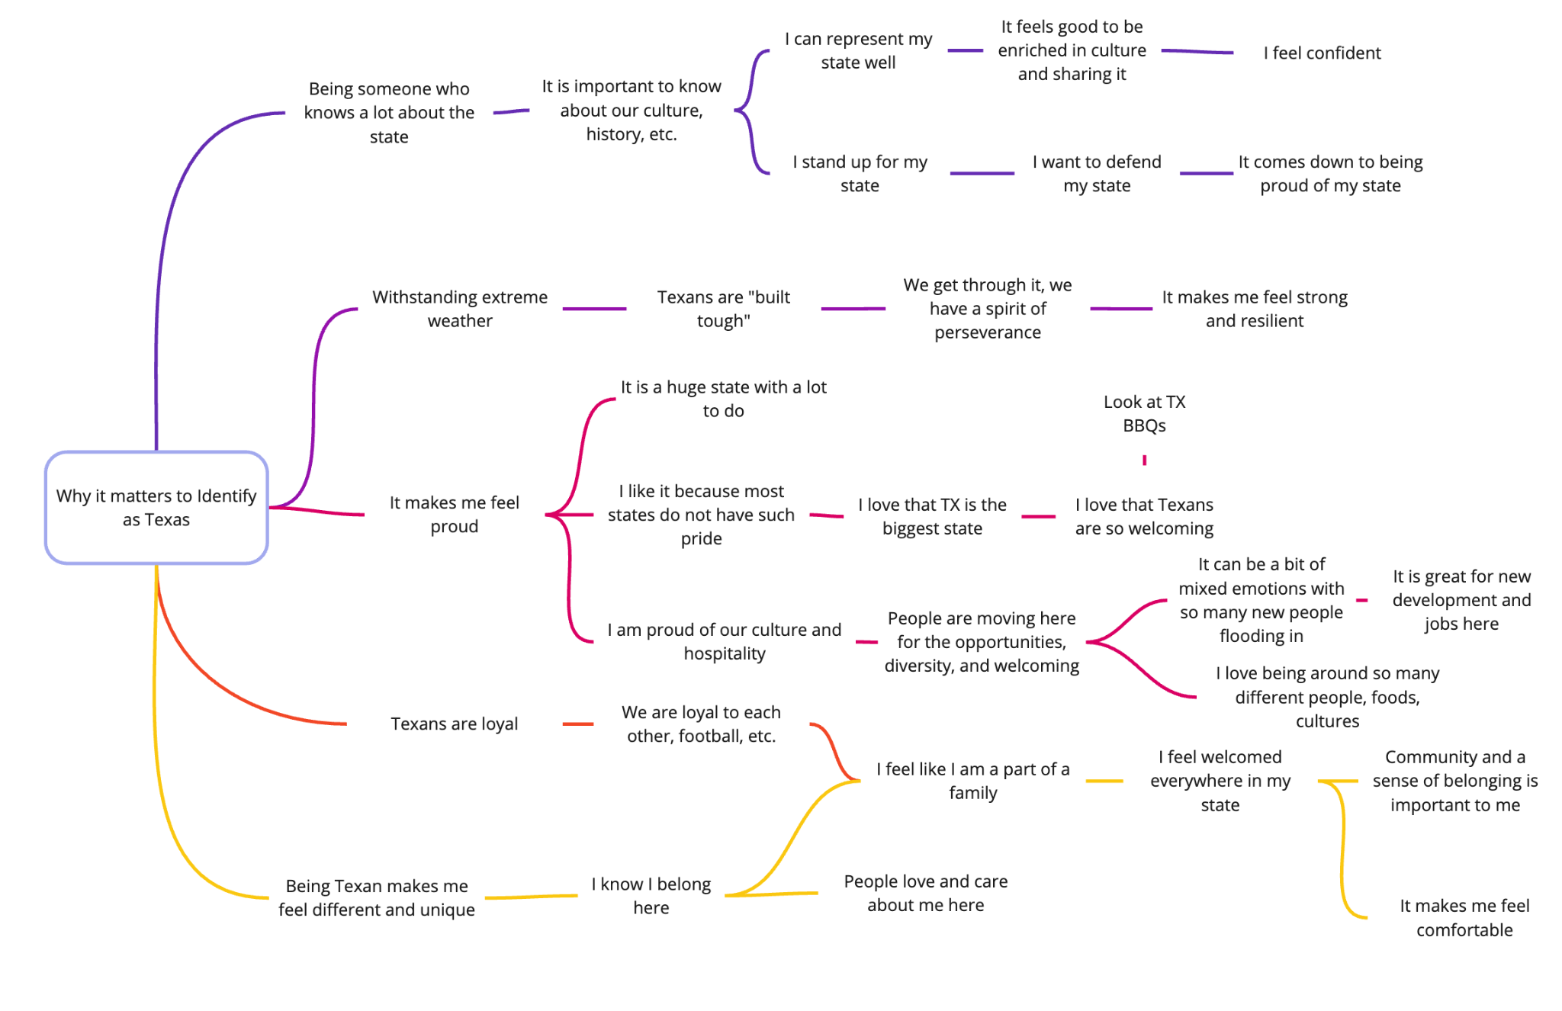
AFRICAN Am’s
“
Texans are ‘built tough.’ We get through, we have a spirit of perseverance. It makes me feel strong and resilient.”
Shatura H., African American

Slide 17
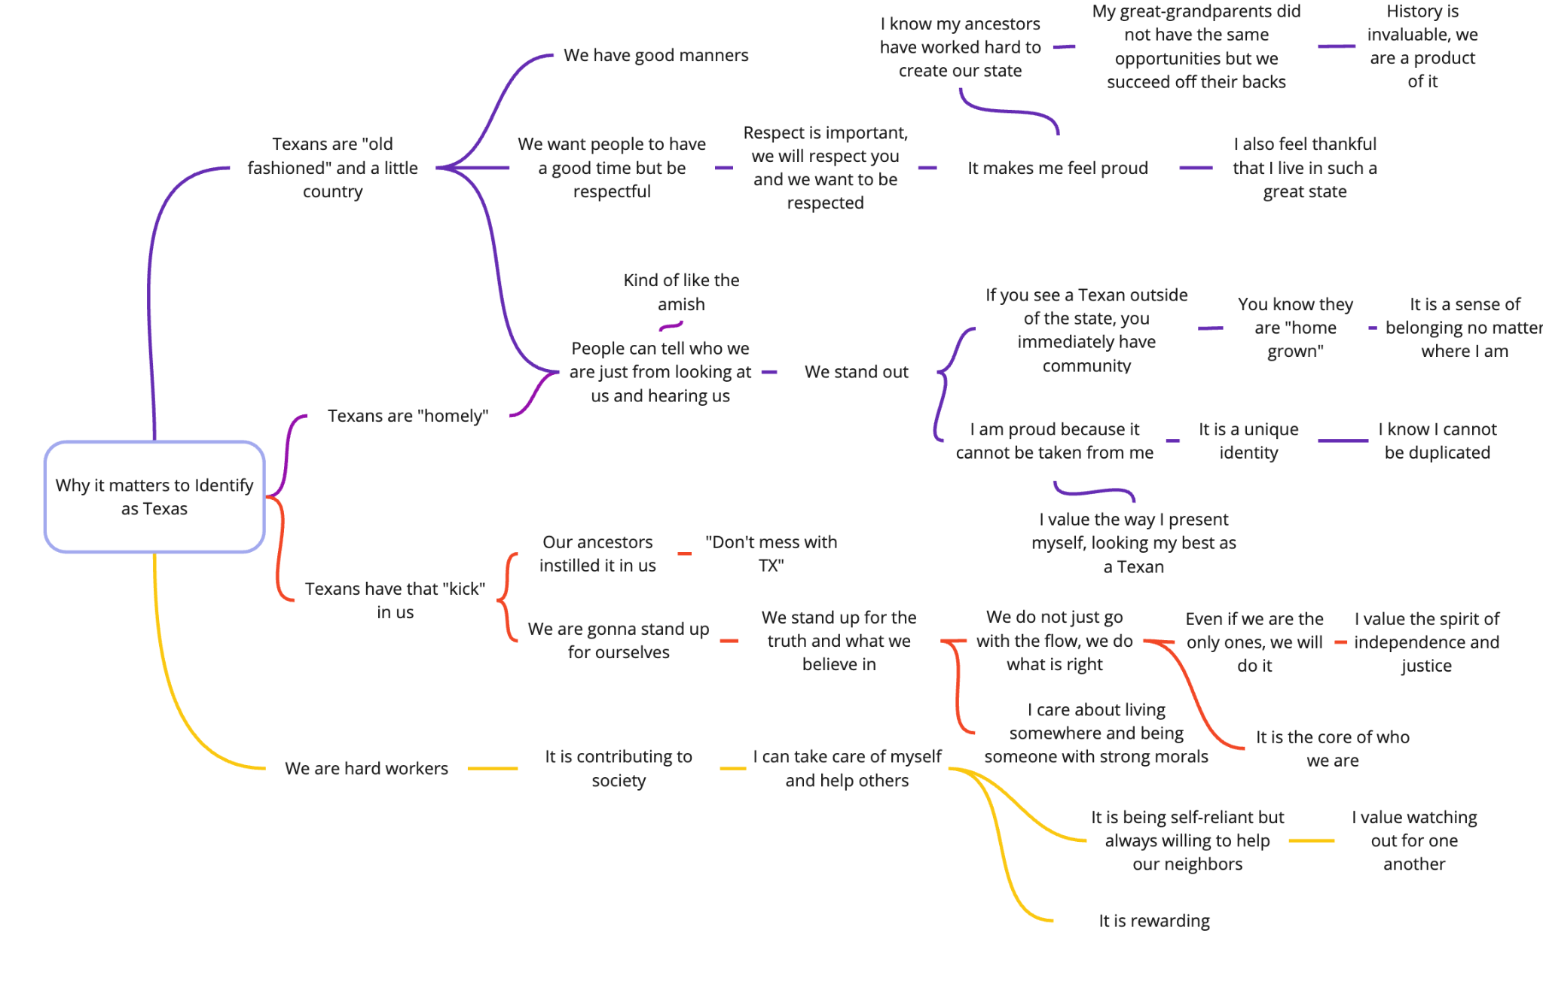
AFRICAN Am’s
“
We stand up for the truth and what we believe in. We do not just go with the flow, we do what is right.”
Rochelle L., African American

Slide 18
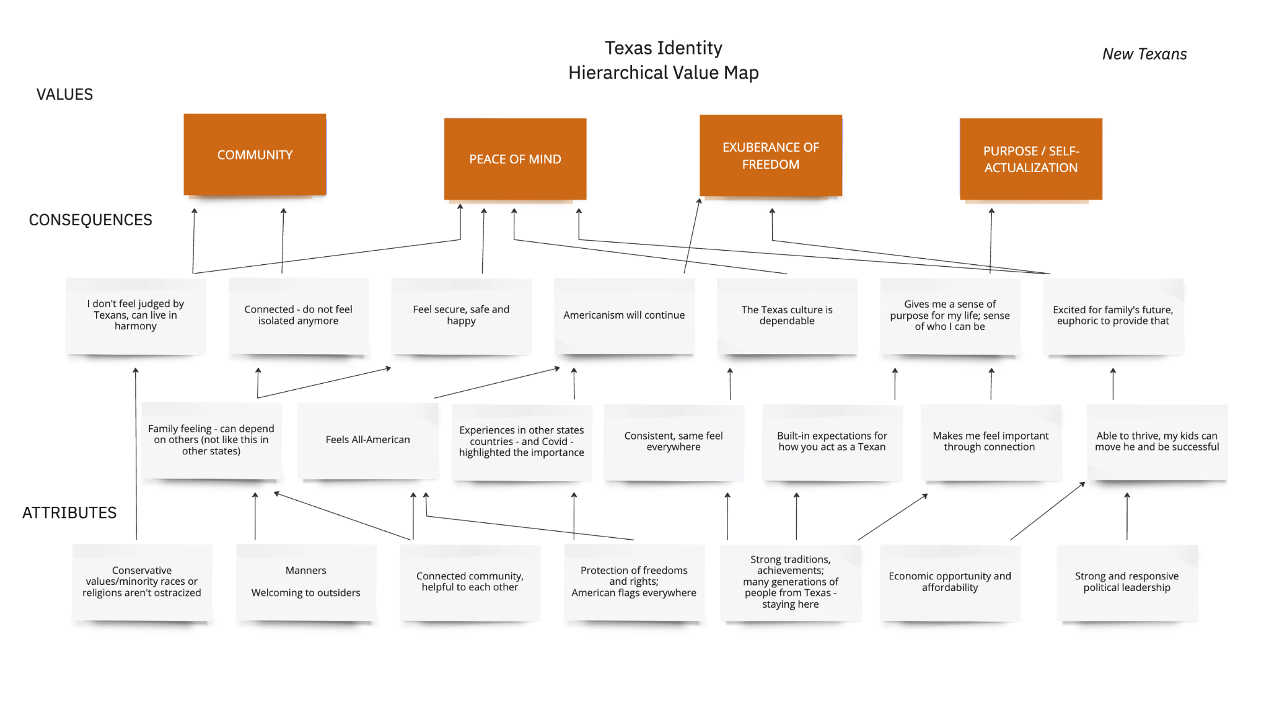

Slide 19
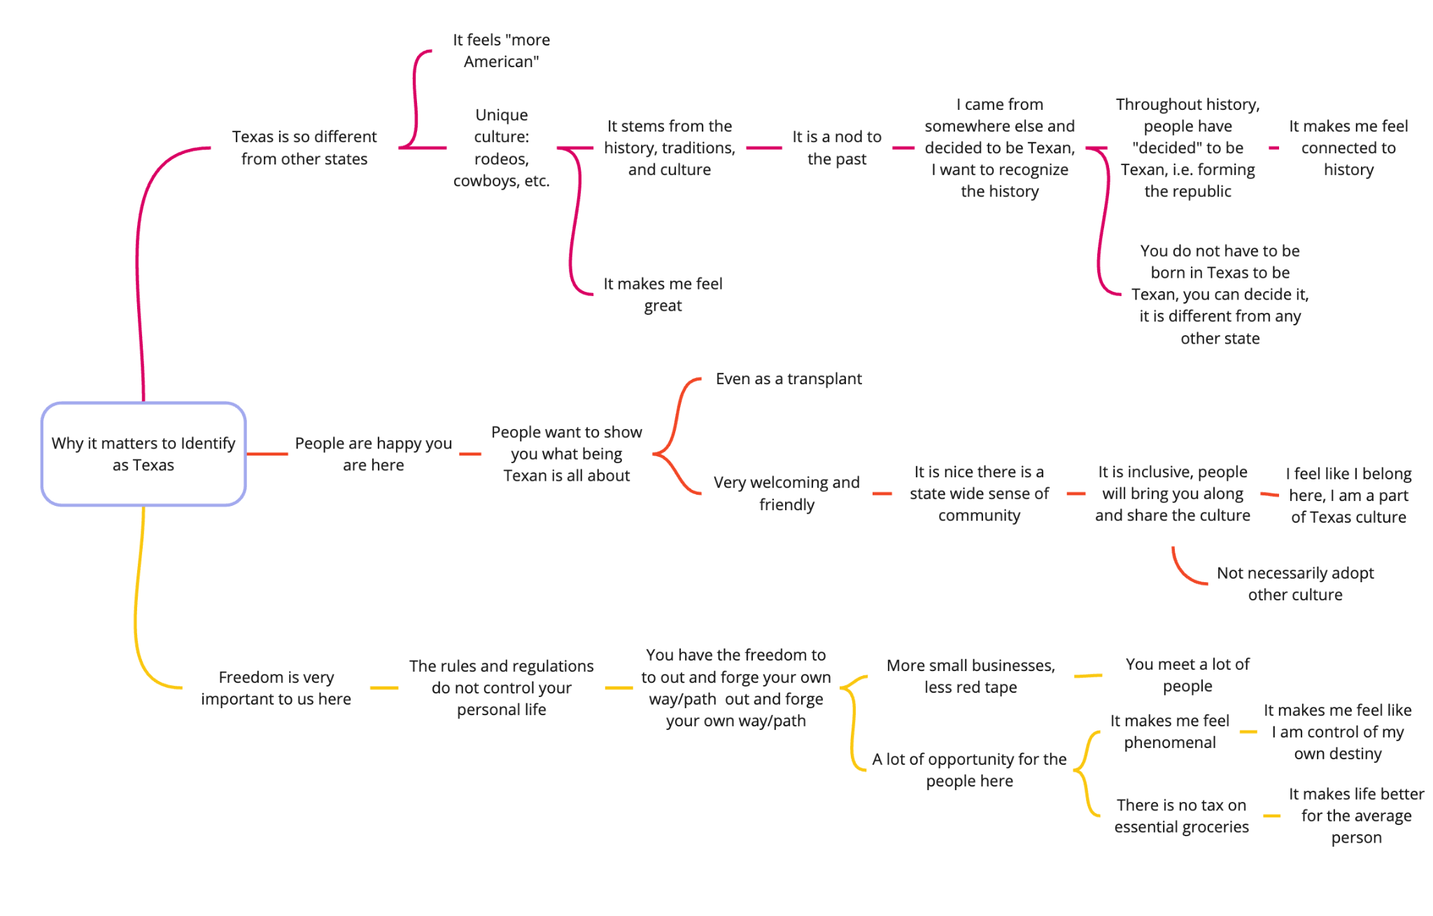
NEW TEXANS
“
"Throughout history, people have 'decided' to be Texan. When they formed the Republic of Texas, people joined together and decided that….In Texas, I am Texan because I chose to be. It makes me feel connected to history."
Benjamin W., New Texan

Slide 20
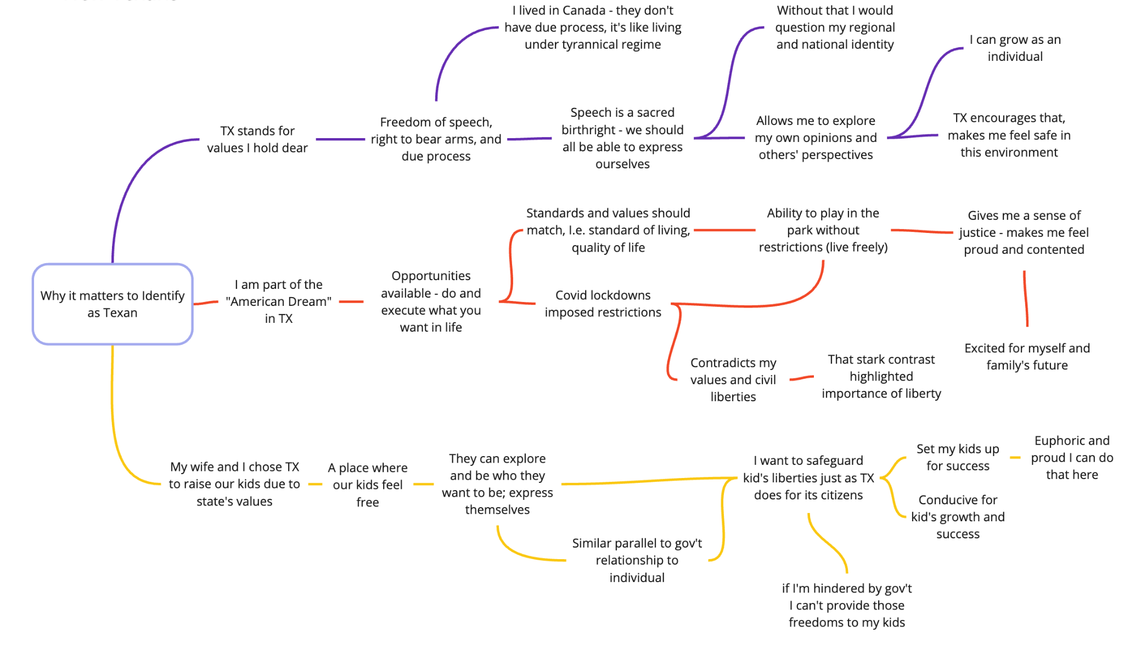
NEW TEXANS
“
My wife and I chose Texas to raise our kids in due to the state’s values. I want to safeguard my kids’ liberties just as Texas does for its citizens.”
Vanshaj R., New Texan

Slide 21
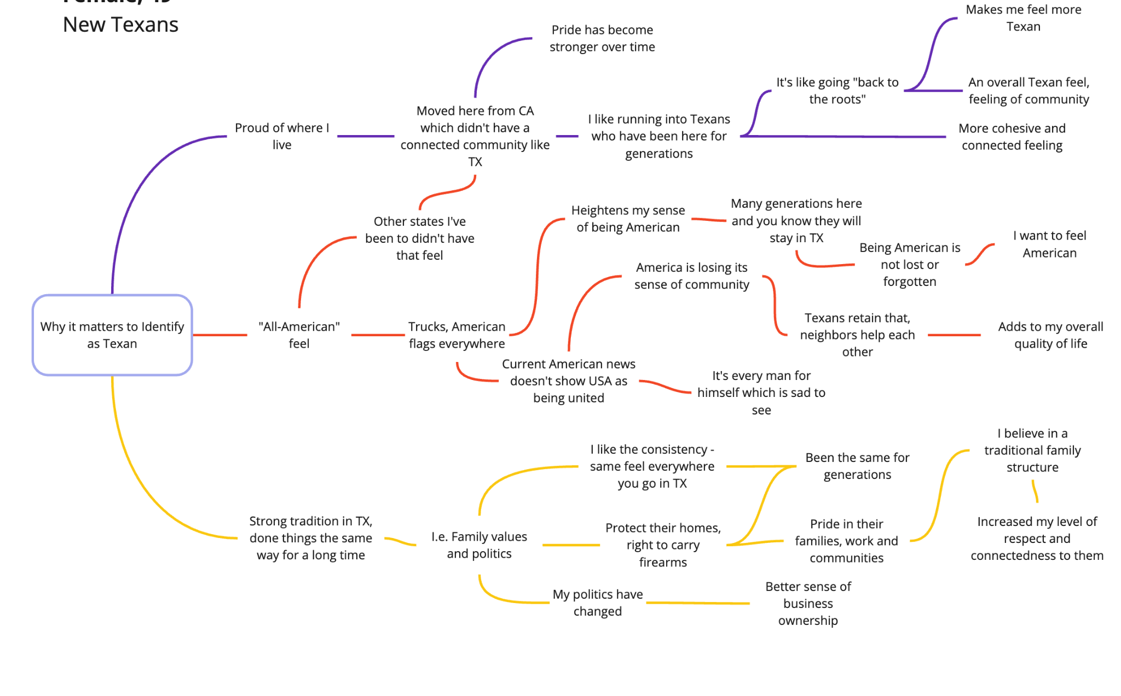
NEW TEXANS
“
I like the consistency – the same feel everywhere you go in Texas. It has been the same for generations.”
Erin P., New Texan

Slide 22
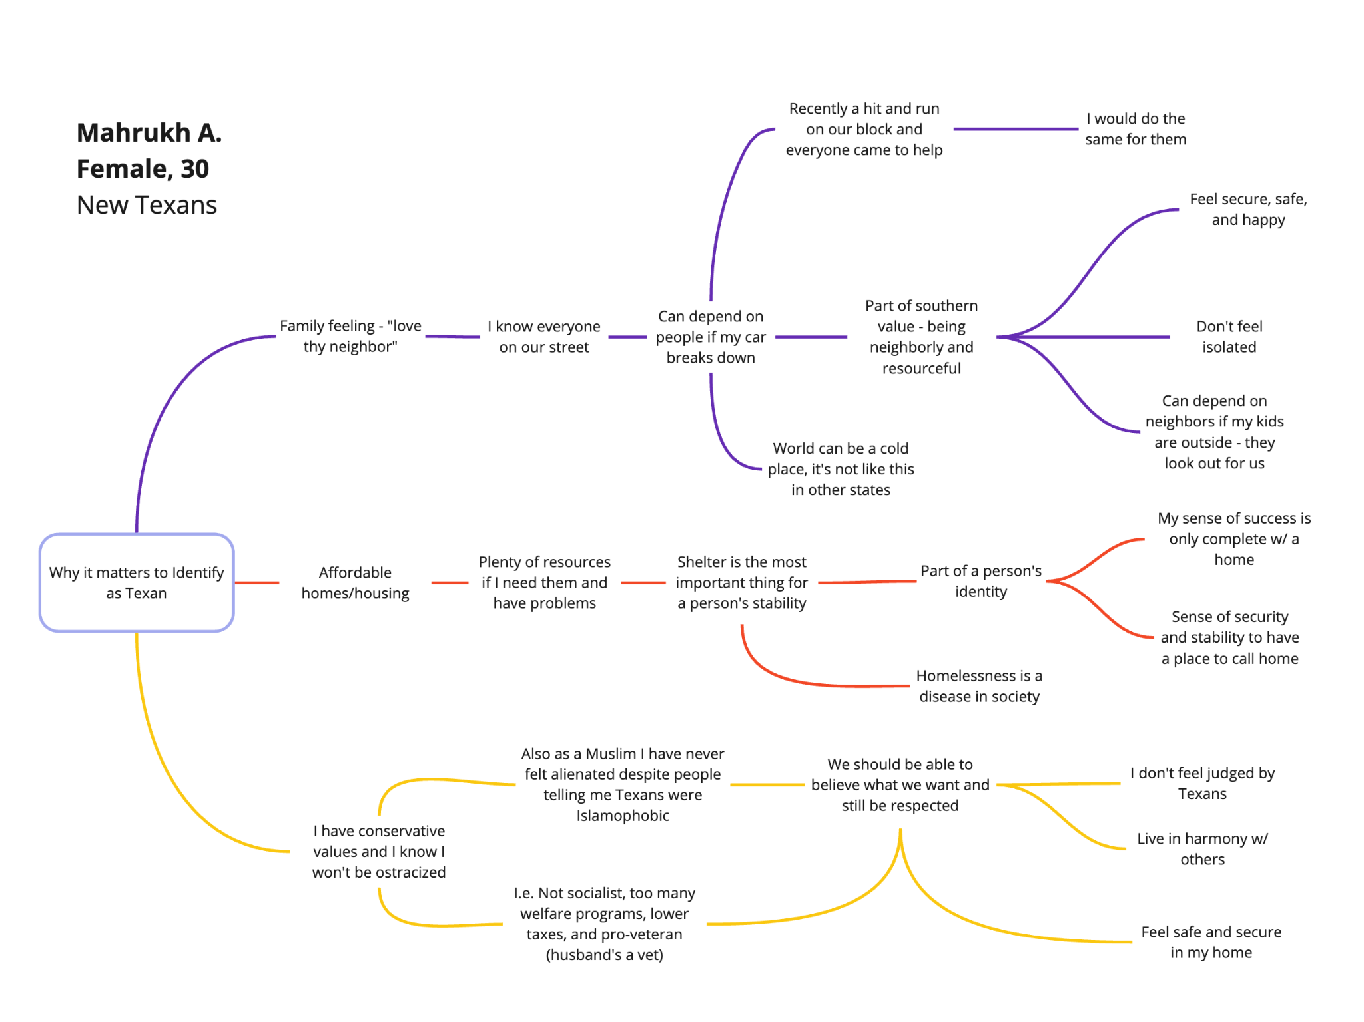
NEW TEXANS
“
I can depend on people if my car breaks down. The world can be a cold place, it’s not like this in other states.”
Mahrukh A., New Texan

Slide 23
PART 2
CONTRASTING SEGMENTS
Contrasting the Native and New Texans reveals how each segments’ view of their Texas Identity speak to their unique situations – and identifies strategies for unity.
PART 2

Slide 24
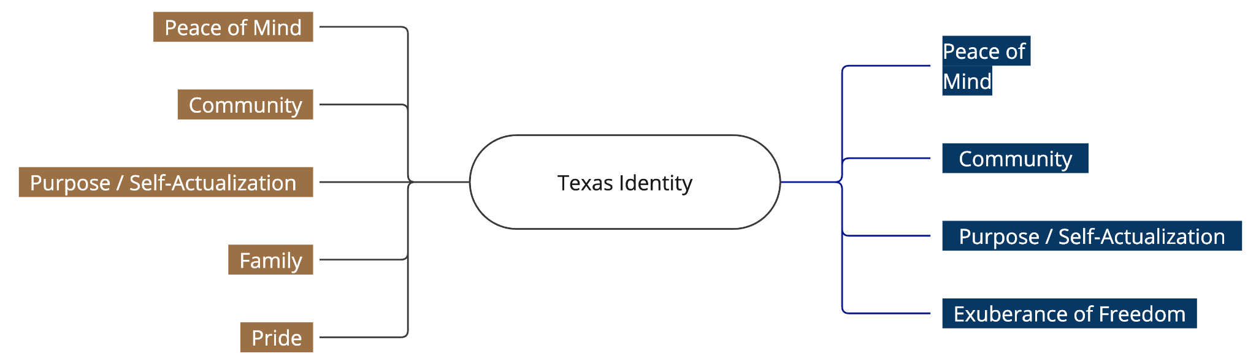
Condensed view of contrasting values
Only New Texans note that beyond the community feeling and accompanying safety and security, there is Happiness - Exuberance - Joy “Texans are united and love it here. In Mexico a lot of people are unsatisfied. People are happy here.” –Mariela G. (New Texan)
Internal stability between Texans, resistance to national culture, reliable community, and sense that the state is self-contained
NATIVE TEXANS
NEW TEXANS
The stability of Texan values across generations is a way to serve the rest of the nation
The two values “family” and “pride” are not felt as strongly by New Texans

Slide 25
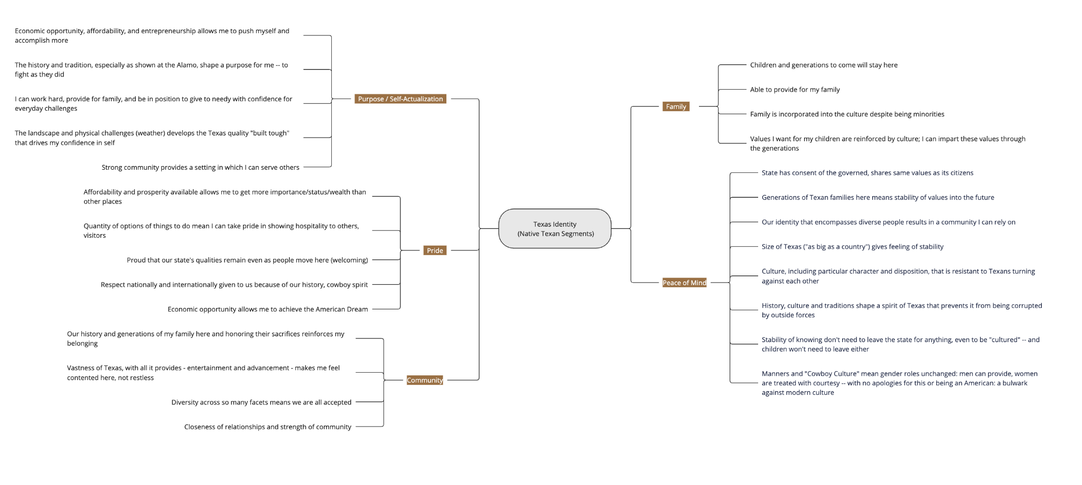
An in-depth look at how the deep values express themselves across segments: Native Texans

Slide 26
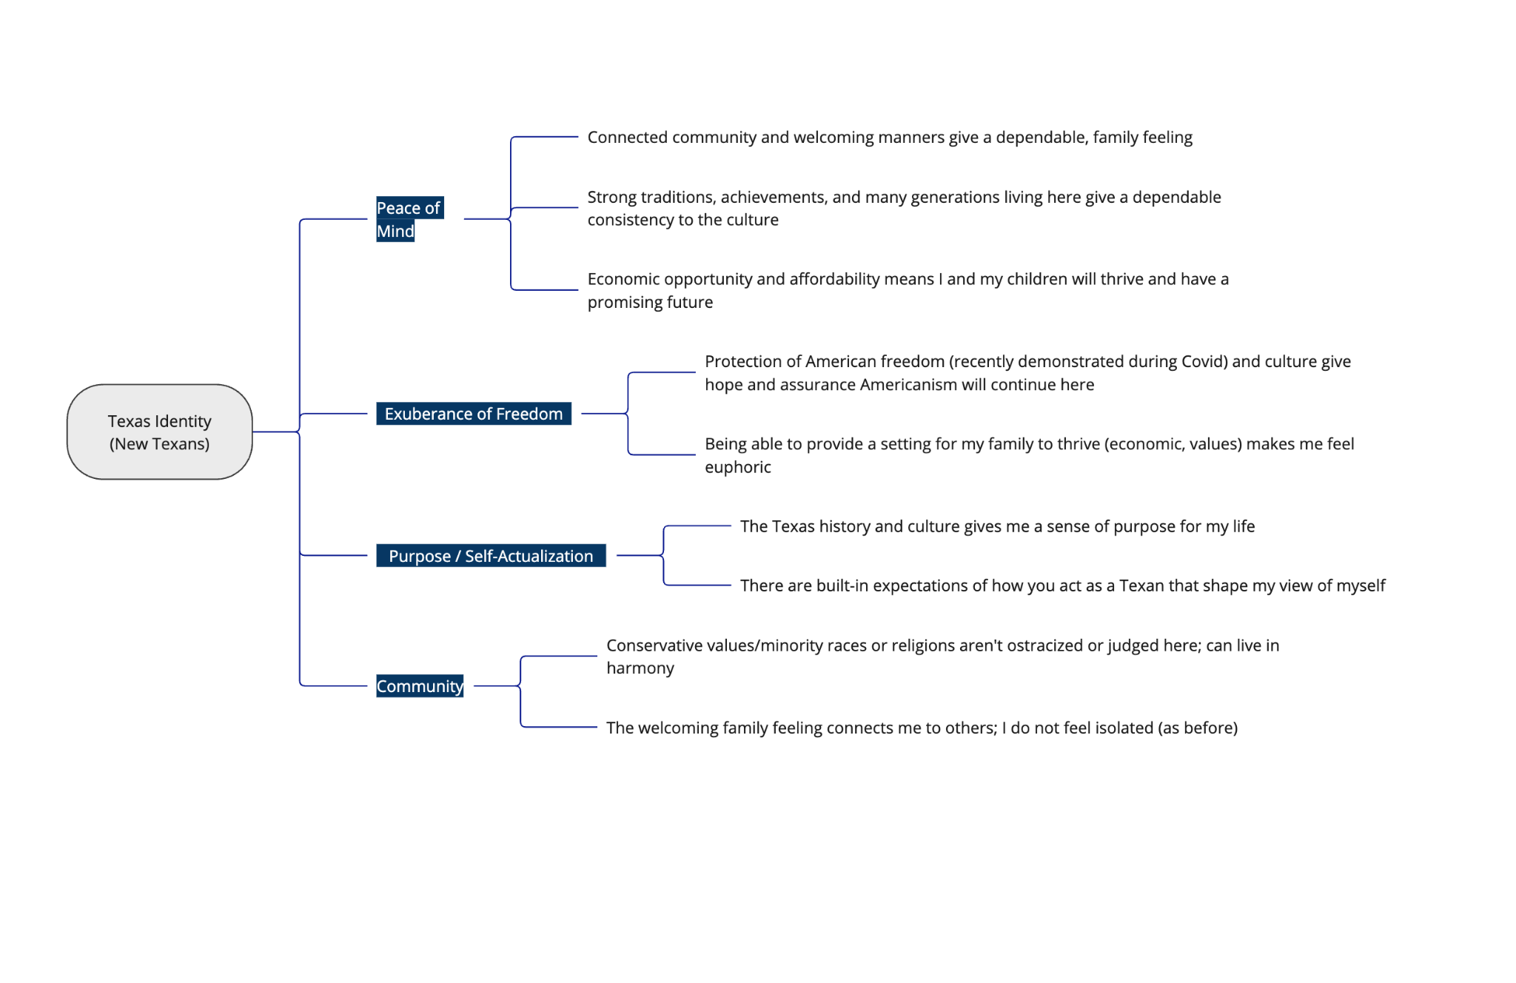
An in-depth look at how the deep values express themselves across segments: New Texans

Slide 27
PART 3
VALUES FRAMEWORK
Contrasting the Native and New Texans reveals how each segments’ view of their Texas Identity speak to their unique situations – and identifies strategies for unity.
PART 3

Slide 28
THE VALUES PLAYBOOK
Values Need States
Texan feel their state identity more acutely when they are reacting to a variety of need states.
Influx of New Texans – Changing National Culture
Peace of Mind & Stability
Establish Legacy and Continue Traditions
Pride
1
4
Provide for Family, See their Flourishing & Acceptance
Family & Community
5
2
Feel Connected; Relate – and Give – to Others
Community
3
Reflect on Who They Are, What they Are Called to Do
Purpose & Self-Actualization
Seek Refuge and Find Hope
Exuberance of Freedom
6

Slide 29
 | STRENGTHEN | EXPAND | MODERNIZE
PURPOSE / SELF-DETERMINATION
Economic climate means you can push to achieve your best
History and the Alamo shape a purpose for Texans - to fight
Financial security here frees you to be in a position to give
We build confidence when subduing land and weather
Texans’ love for each other and gathering provides a setting to serve others
Built-in expectations of how Texans act shape self-perception
PRIDE
You will be proud of what you achieve/how you will prosper
Take pride in being excellent hosts and amazing your guests
What makes Texas special remains unchanged throughout the generations; a welcome going forward even in this age
The country and world know of Texas’s renown and history
The American Dream is still possible to achieve in Texas
COMMUNITY
Our history and generations of my family here and honoring their sacrifices reinforces my belonging
Vastness of Texas, with all it provides - entertainment and advancement - makes me feel contented here, not restless
Diversity across so many facets means we are all accepted
Closeness of relationships and strength of community
Conservative values/minority races or religions aren't ostracized or judged here; can live in harmony
The welcoming family feeling connects me to others; I do not feel isolated (as before)
 | STRENGTHEN | EXPAND | MODERNIZE
FAMILY
Children and generations to come will stay here
Able to provide for my family
Family is incorporated into the culture despite being minorities
Values I want for my children are reinforced by culture; I can impart these values through the generations
PEACE OF MIND
State has consent of governed, shares values with citizens
Generations of families here = stability of values into the future
Diversity of people in state identity feels reliable, secure
Size of Texas ("as big as a country") gives feeling of stability
Culture that is resistant to Texans turning against each other
History, culture and traditions shape a spirit of Texas that prevents it from being corrupted by outside forces
Stability of knowing don't need to leave the state for anything, even to be "cultured" -- and children won't need to leave either
Manners and "Cowboy Culture" mean gender roles unchanged: a bulwark against modern culture
Community and manners give a dependable, family feeling
Strong traditions, achievements, and many generations living here give a dependable consistency to the culture
Economic opportunity and affordability means I and my children will thrive and have a promising future
EXUBERANCE OF FREEDOM
Protection of American freedom (see: Covid) and culture give hope and assurance Americanism will continue here
Euphoric feeling at being able to provide for family
THE VALUES PLAYBOOK
A framework to incorporate values into strategies
Three strategies for utilizing these insights for the Texas Identity:
STRENGTHEN
Establishing a more cohesive and consistent Texas Identity story, and deploying this as a lens for the choices and events presented to them.
EXPAND
Growing the share of Texans who adopt the Texas Identity – in particular, where New Texans have not yet connected with the same values or pathways to value, consider expanding Native Texan values to them.
MODERNIZE
To start, add values of New Texans to the network of Native Texans’ values. Creating a more modern and relevant identity that relates to the current social and political climate and uses insights from the New Texans’ sense of Texas Identity.
For example, New Texans described their Texas experience during Covid as affirming their prioritization of protecting freedoms – they are aware of the changing national culture but haven’t yet identified what native Texans reported in terms of the gender wars; that Texas’s commitment to courtesy is another facet of defending against disintegration of American values nationally.

Slide 30
NEXT STEPS
Convey the story of “Who Texans Are” back to them
Identify opportunity areas to apply Texas Identity (policy areas, legislation, issues)
Filter and direct expressions of the Texas Identity through the values identified

Slide 31
STUDY SPECIFICS
Column 1 | Total (n) | (%) | Mexican A. (n) | (%) | African A. (n) | (%) | South Asian (n) | (%) | New Texans (n) | (%)
Total | 60 | 100% | 15 | 100% | 15 | 100% | 15 | 100% | 15 | 100%
Women | 35 | 58.3% | 10 | 66.7% | 9 | 60.0% | 4 | 26.7% | 12 | 80.0%
Men | 25 | 41.7% | 5 | 33.3% | 6 | 40.0% | 11 | 73.3% | 3 | 20.0%
18-24 | 2 | 3.3% | 0 | 0.0% | 0 | 0.0% | 0 | 0.0% | 2 | 13.3%
25-34 | 9 | 15% | 2 | 13.3% | 1 | 6.7% | 3 | 20.0% | 3 | 20.0%
35-44 | 27 | 45% | 6 | 40.0% | 6 | 40.0% | 10 | 66.7% | 5 | 33.3%
45-54 | 11 | 18% | 4 | 26.7% | 4 | 26.7% | 1 | 6.7% | 2 | 13.3%
55-70 | 11 | 18.3% | 3 | 20.0% | 4 | 26.7% | 1 | 6.7% | 3 | 20.0%
White or Caucasian | 6 | 10.0% | 0 | 0.0% | 0 | 0.0% | 0 | 0.0% | 6 | 40.0%
Black or African American | 17 | 28.3% | 0 | 0.0% | 15 | 100.0% | 0 | 0.0% | 2 | 13.3%
Hispanic | 16 | 26.7% | 15 | 100.0% | 0 | 0.0% | 0 | 0.0% | 1 | 6.7%
Asian | 21 | 35.0% | 0 | 0.0% | 0 | 0.0% | 15 | 100.0% | 6 | 40.0%
Trump vote (future) | 29 | 48.3% | 7 | 46.7% | 6 | 40.0% | 9 | 60.0% | 7 | 46.7%
Harris vote (future) | 26 | 43.3% | 8 | 53.3% | 8 | 53.3% | 4 | 26.7% | 6 | 40.0%
Unsure (future) | 5 | 8.3% | 0 | 0.0% | 1 | 6.7% | 2 | 13.3% | 2 | 13.3%
Hindu |  |  |  |  |  |  | 9 | 60%
Muslim |  |  |  |  |  |  | 6 | 40%
Insights Framework The Frontier Lab
for TPPF

